Slide 1
Current fragmentation and particle acceleration in strongly turbulent plasma
Loukas Vlahos
Aristotle University,
Thessaloniki, Greece

Slide 2
Main topics
MHD turbulence leads to current fragmentation, current sheets and magnetic reconnection
Current sheets and current fragmentation are also driven by stressed magnetic fields
Distributed dissipation sites in current sheets and formation of distributed accelerators (E-fields)
Particle acceleration in distributed localized E-fields
Conclusions

Slide 3
The main theme of this talk is “From fully developed turbulence to Current Sheets and reconnection and from reconnection to fully developed turbulence”
This work started almost 25 years ago and is still work in progress from several groups around the world.
I have no time to review extensively the published work on how turbulence can lead to current sheets and reconnection and vise versa, but the bottom line is that no matter how we start, our system eventually reaches a fully developed turbulent magnetic stressed environment where the current sheets are distributed in space.
This environment has nothing to do with “weak turbulence” and the quasi linear evolution of particles inside stochastic waves

Slide 4
In how many natural systems the interplay between turbulence and reconnection is active?
Convection zone in stars and the solar atmosphere, where coronal heating, flares and Coronal Mass Ejections are the observational consequences
Solar wind and relativistic flows in astrophysical jets
Earth’s Magnetotail
Many astrophysical sites
Fusion devices

Slide 5
From 3D Resistive mhd turbulence to current sheets

Slide 6
Dimitruk and Matthaeus, ApJ, 2003
Dimitruk, Matthaeus and Seenu, ApJ, 2004
These articles extended previous work by Matthaeus and Lamkin, 1989 and Biskamp and Welter 1989.
They start with a DC magnetic Β and add a fluctuating field δΒ comparable to B. They use the 3D compressible MHD equations to follow the evolution of these fluctuations.
The overall picture they present is that CS formed as natural evolution of turbulent MHD fields

Slide 7
The Electric fields?
Very few MHD simulations present the Electric field explicitly along there simulations

Slide 8
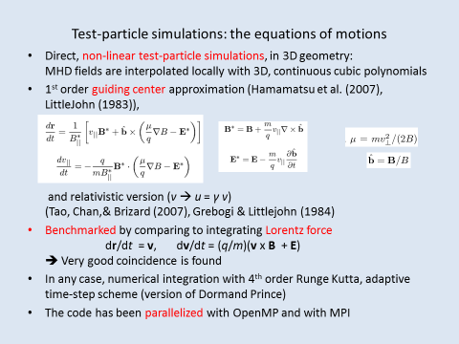

Slide 9

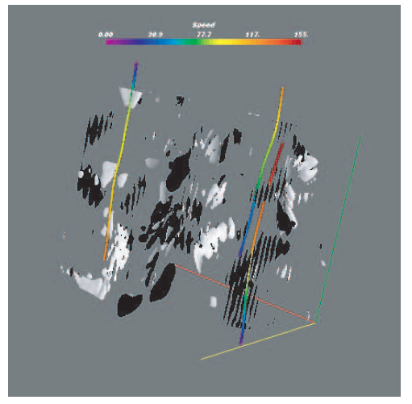
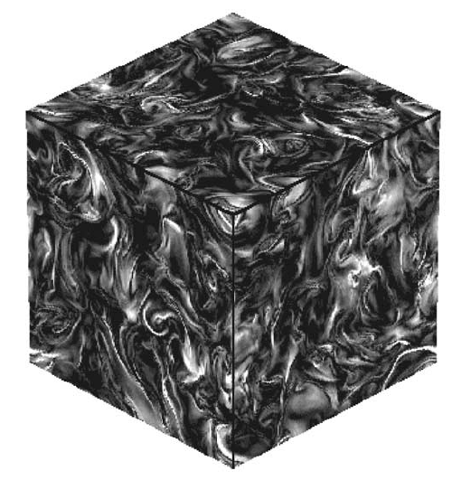
Test particle acceleration in three-dimensional Hall MHD
turbulence
P. Dmitruk and W. H. Matthaeus
JGR, 2006

Slide 10
Statistical properties of currents sheets

Slide 11
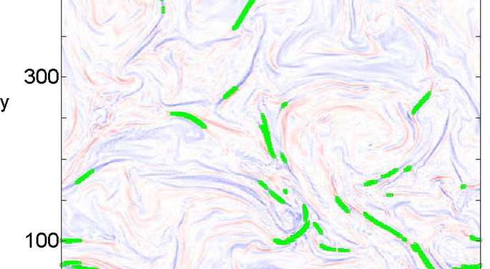
Statistical analysis of current sheets in three dimensional MHD turbulence
Zhadankin et al, ApJ, 2013

Slide 12
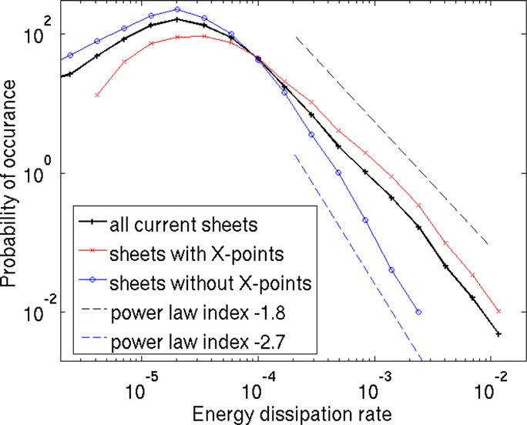
Energy dissipation rate

Slide 13
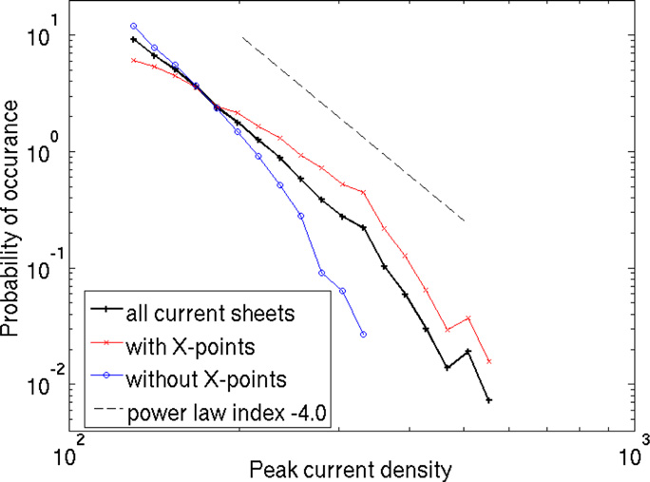
Peak current density

Slide 14
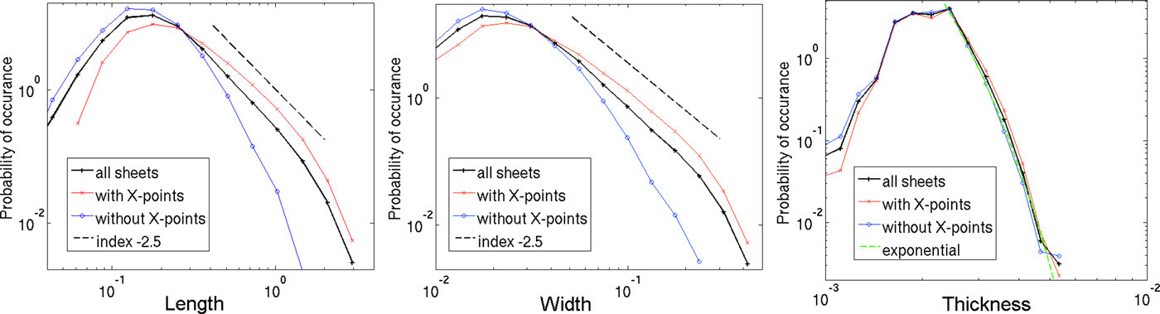

Slide 15
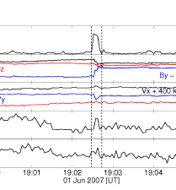
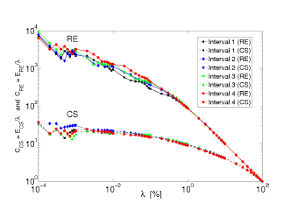
Solar Wind data

Slide 16
Current shheets formation driven from the boundary

Slide 17

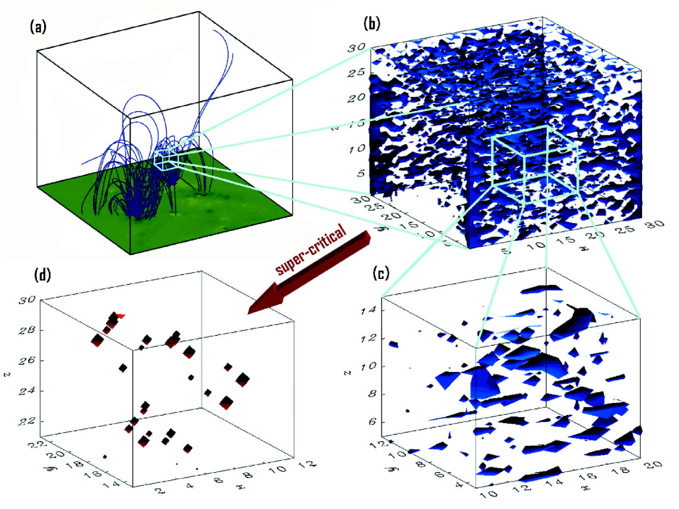
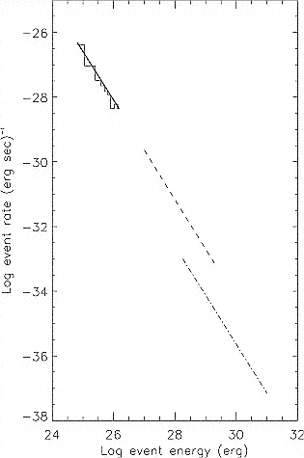
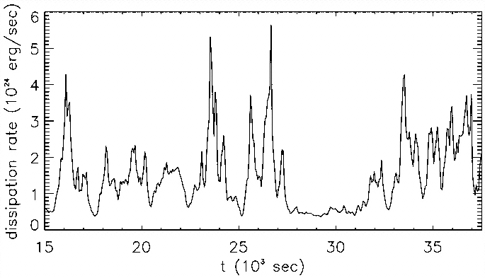
Expected consequences of turbulence
Vlahos et al. (2004)
Dmitruk et al. (1998)
Dmitruk & Gomez (1997)
Hierarchical self-organization, which gives rise to tremendous spatial complexity
Spatial self-similarity (scale invariance & fractal structures)
Intermittency in the energy release process
Power laws in the statistical behavior of the system
8/12
SIPWII 04

Slide 18
Externally Stressed magnetic loops

Slide 19
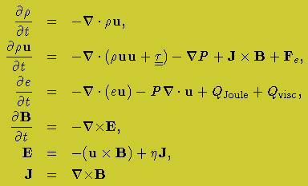
MHD Equations

Slide 20
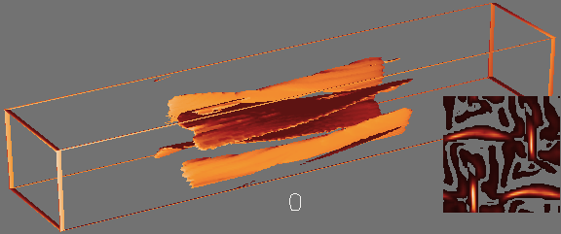
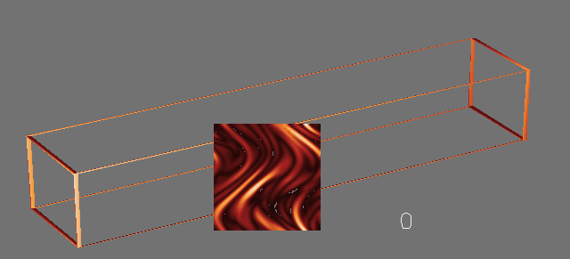
The stochastic loop model (Galsgaard)
3D MHD experiment of photospherically driven slender magnetic flux tubes
Continued random driving of the foot points (incompressible sinusoidal large scale shear motions )
Reconnection jets generate secondary perturbations in B
Formation of stochastic current sheets

Slide 21
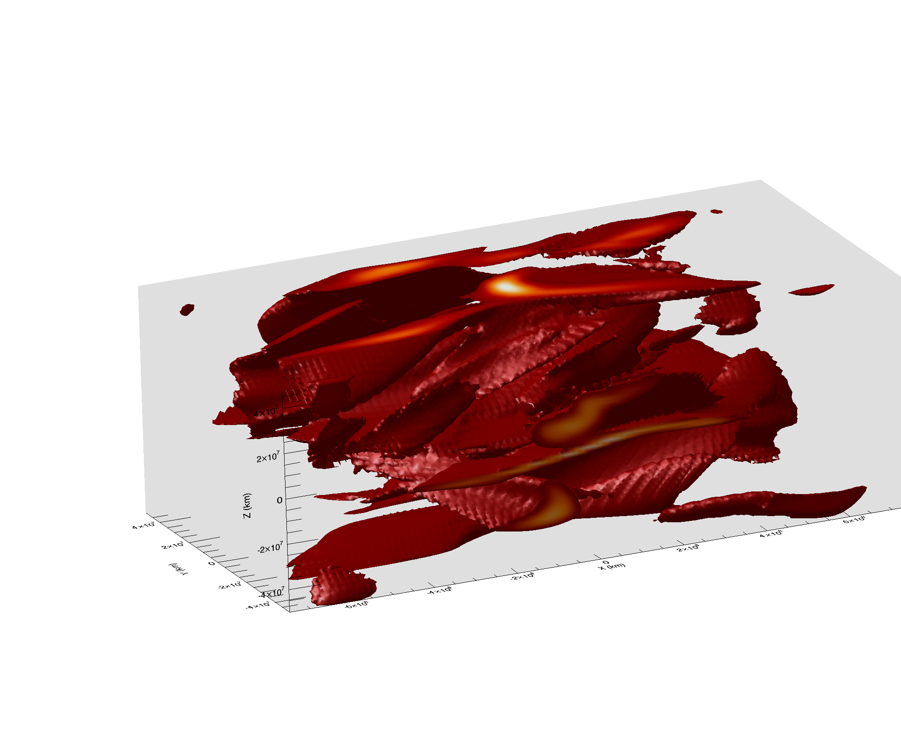
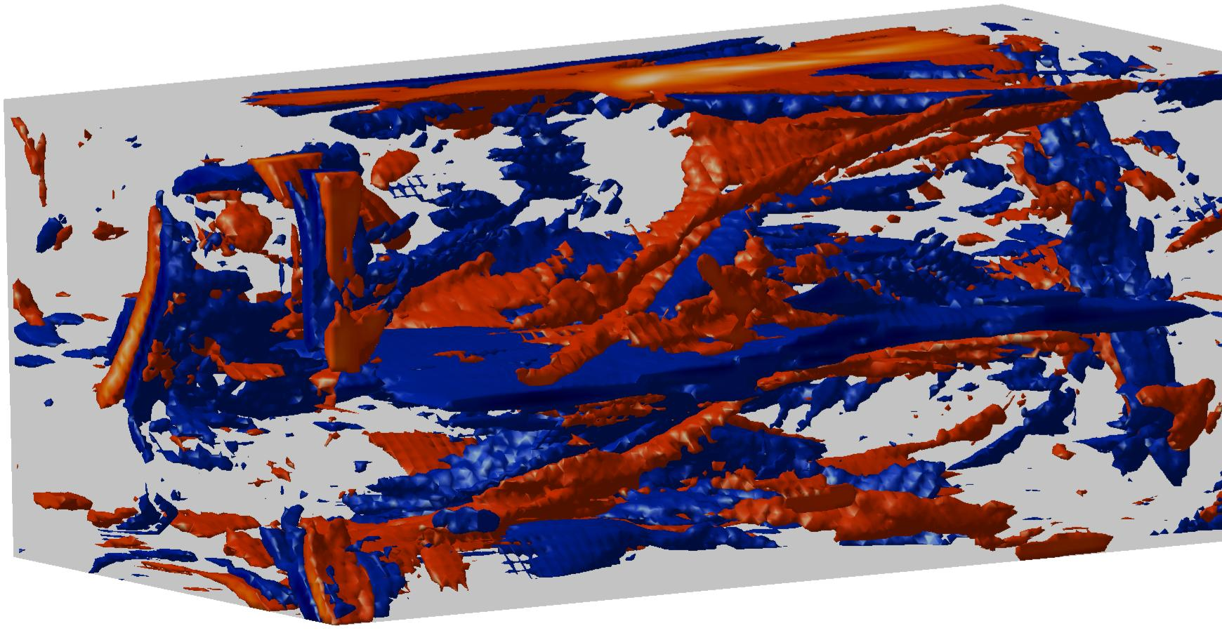
Global E-field:
Convective field plays no role……

Slide 22
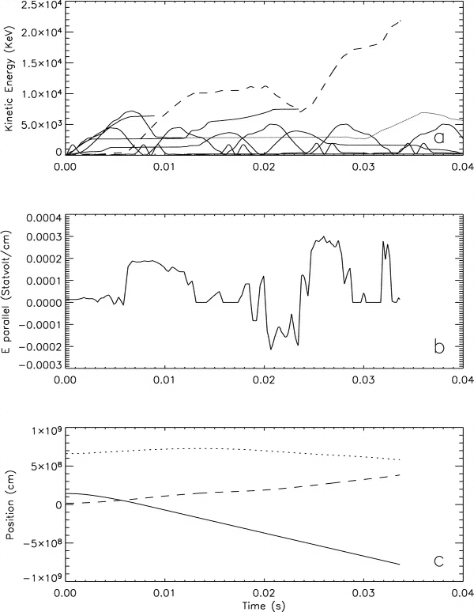
Energy
Sample Particles
Fast acceleration
  0.1 (1) sec for e⁻(p⁺)
Encounters multiple acceleration sites.
74 % are accelerated (> 1 keV)
  40 % Leave from either footpoint
  13 % Leave from the sides
  21 % Trapped
26 % Not accelerated
E-field
Sample electron

Slide 23
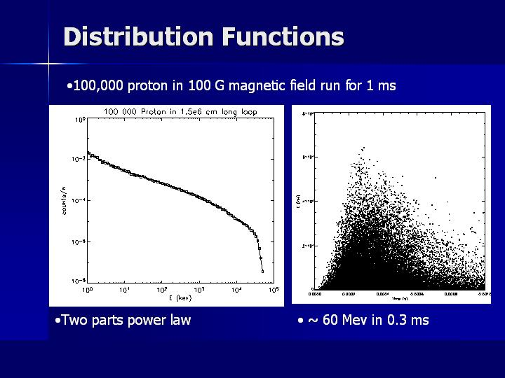

Slide 24
The role of non uniform resistivity

Slide 25
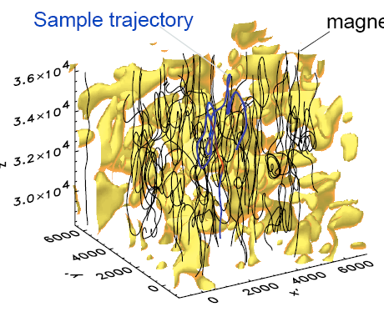
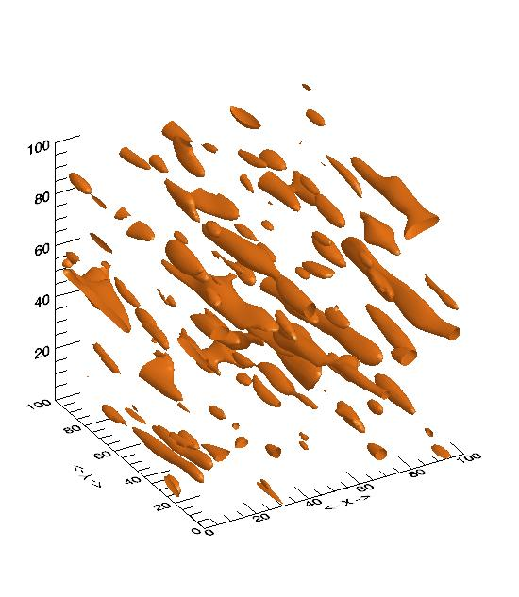
A ‘Turbulent’ Field Model
(stochastic but not resonant accelerator)
(Azner+Vlahos, APJL, 2004)
threshold j_{c}

Slide 26
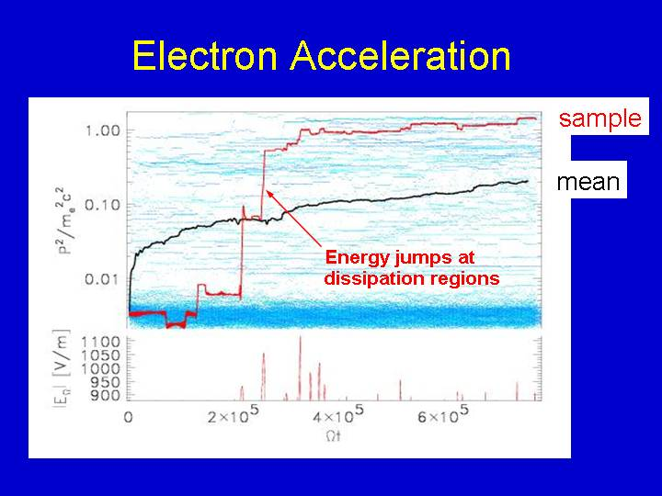

Slide 27
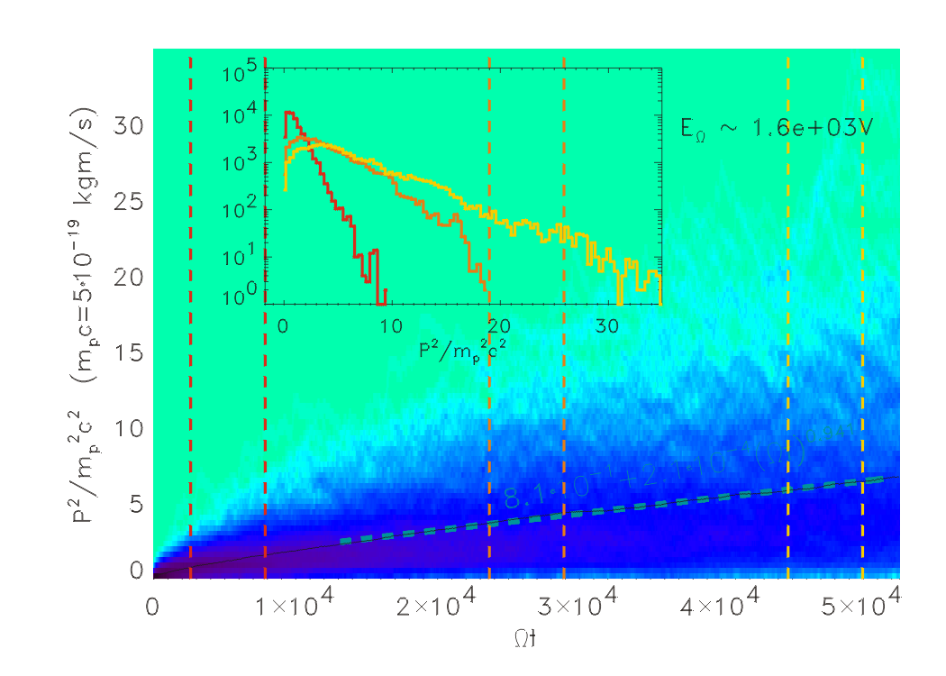

Slide 28
From Current sheets to turbulence

Slide 29
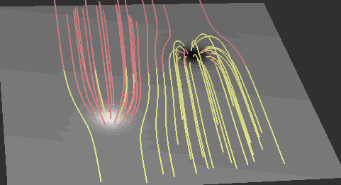
Dynamic Evolution of large scale current sheets

Slide 30
Description of the simulation
Incompressible, viscous, dimensionless MHD equations:
B is the magnetic field, V the plasma velocity and P the
kinetic pressure.
and
are the magnetic and kinetic Reynolds numbers.

Slide 31
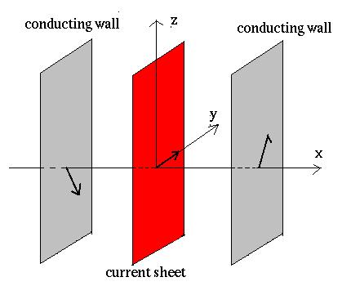
Geometry
The MHD incompressible equations are solved to study magnetic
reconnection in a current layer in slab geometry:
Periodic boundary conditions
along y and z directions
Dimensions of the domain:
-l_{x} < x < l_{x}, 0 < y < 2πl_{y}, 0 < z < 2πl_{z}

Slide 32
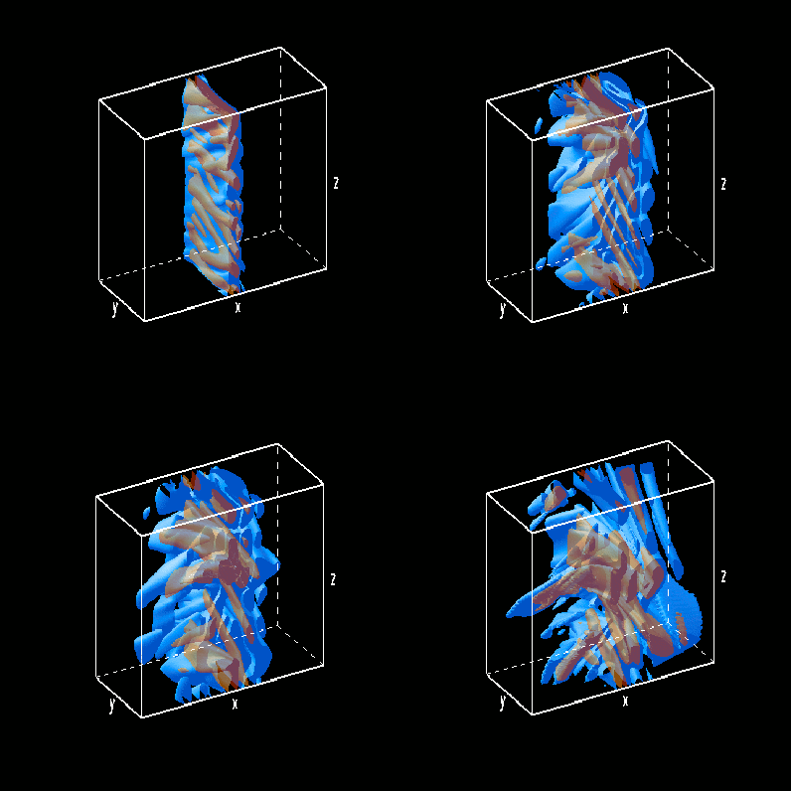
Three-dimensional structure of the electric field
Isosurfaces of the electric filed at different times
t=50
t=200
t=300
t=400

Slide 33
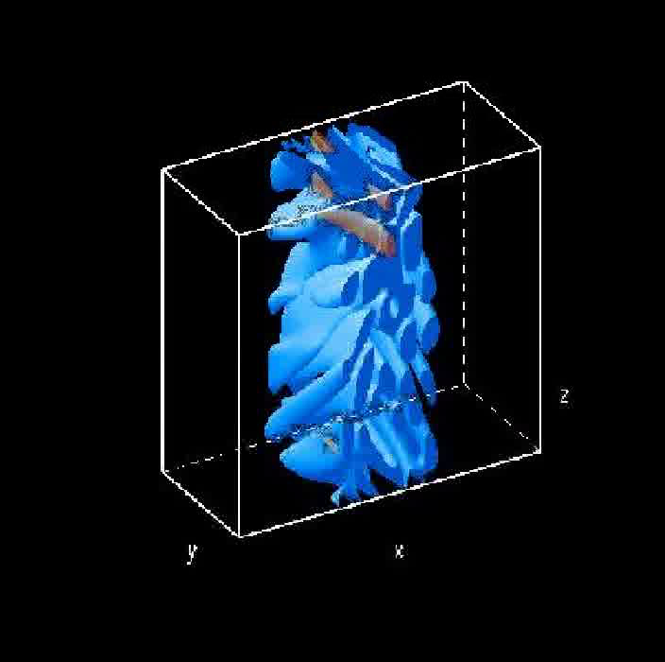
Time evolution of the electric field
Isosurfaces of the electric field from t=200 to t=400

Slide 34
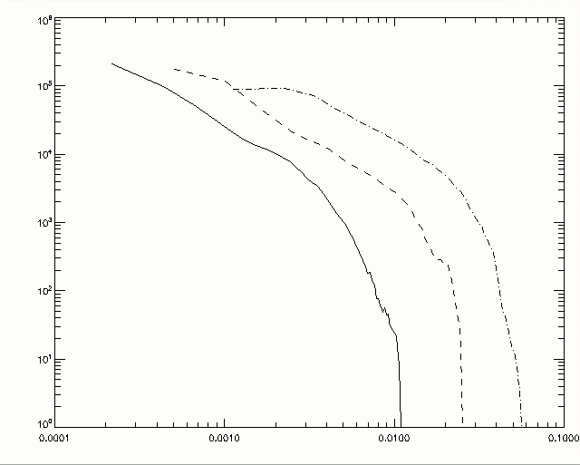
Distribution function of the electric field
P(E)
t=300
t=200
t=400
E

Slide 35
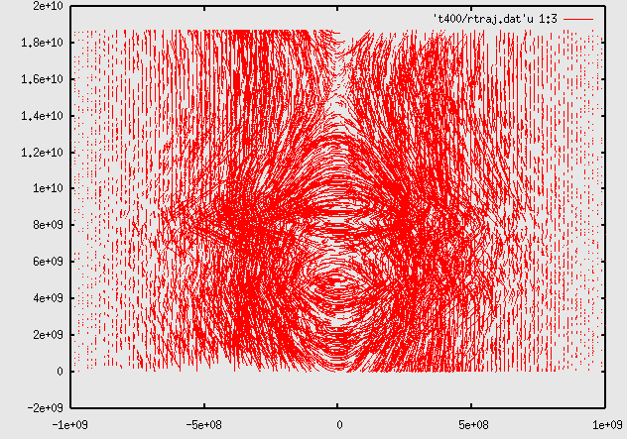
Trajectories of particles in the xz plane
The trajectories of the particles are simpler near the edges than in the center, where they are accelerated by the turbulent electric field

Slide 36
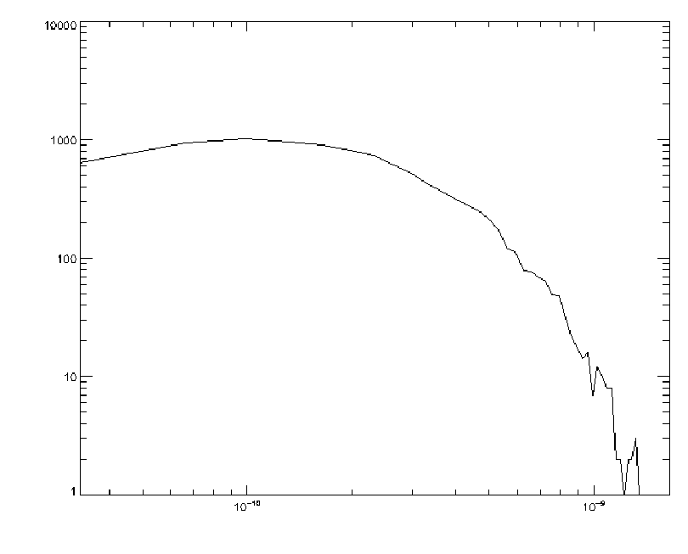
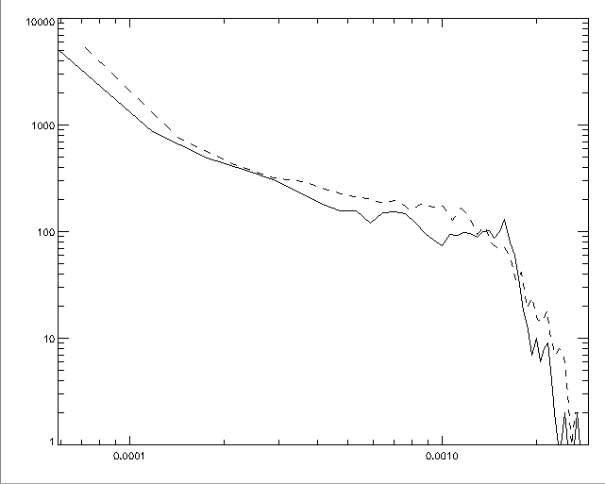
Initial and final distribution function of particles for different electric fields
P(E)
t=300
t=400
E (erg)
E (erg)

Slide 37
3d pic simulations on current sheet evolution

Slide 38
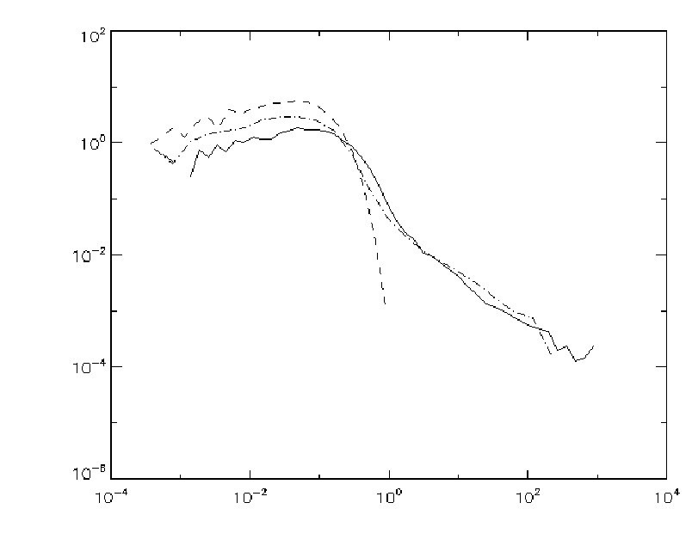
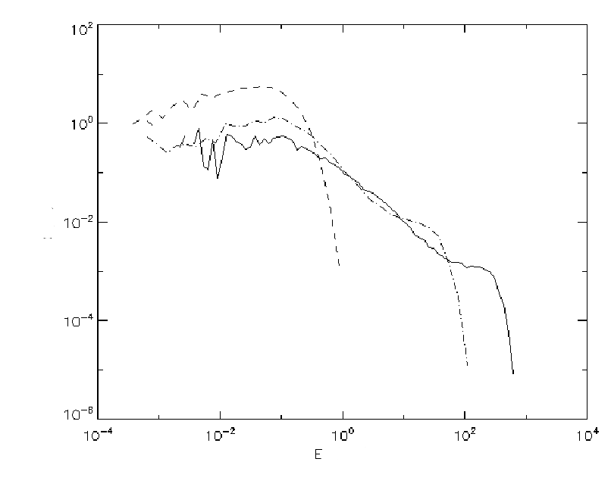
Kinetic energy distribution function of electrons
t=50 TA
T=400 TA
P(Ek)
Ek (keV)
Ek (keV)

Slide 39
Gyrokinetic simulations of current sheets

Slide 40
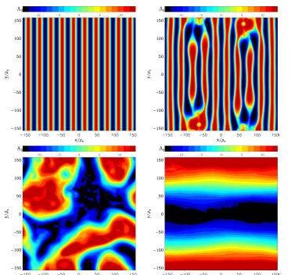
Gyrokinetic simulations on magnetic reconnection
Pueschel et al, PoP 2211

Slide 41
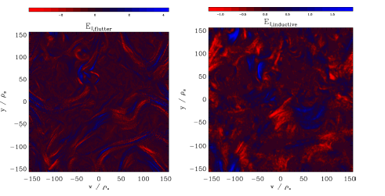

Slide 42
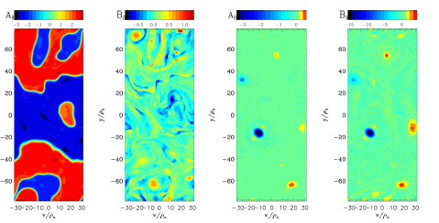

Slide 43
Continuous Time random walk

Slide 44
Particle dynamics in a fractal distribution of fragmented currents
From the data presented above we have estimated
The probability distribution of the Volumes of the fragmented currents
where A is the normalization factor
We use p_{V}(V) to determine the random size of the Unstable Current Sheets

Slide 45
The probability distribution of the distance between the current fragments
In 2003 Isliker and Vlahos (PRD, vol 67 , page 26412 ) present an estimate of the probability of the distance s between fractaly distributed CS
Based on this we can find the distance a particle travels before it will interact with a new current sheet

Slide 46
Distribution of Currents and Electric fields
The probability distribution of currents p_{j}(<j>)
and from this we estimate the probability distribution of Electric fields, since for j>j_{th} the resistivity becomes anomalous (η_{an}) and E=η _{an} <j>

Slide 47
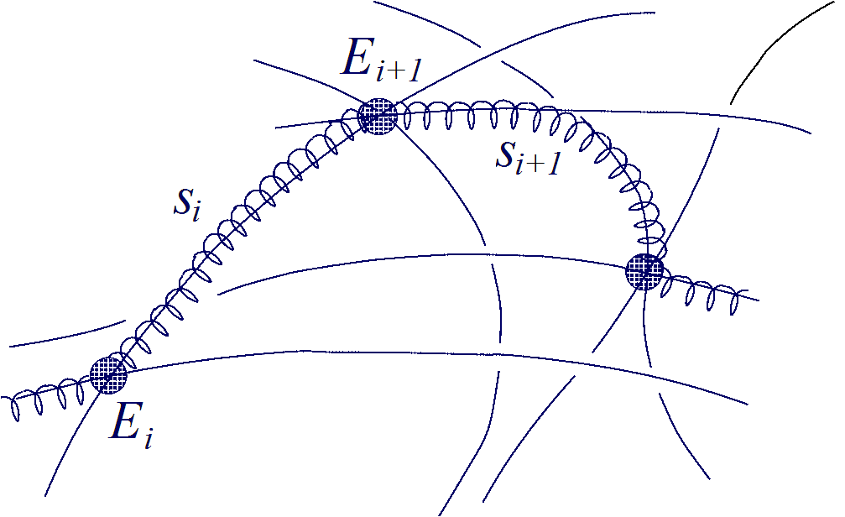
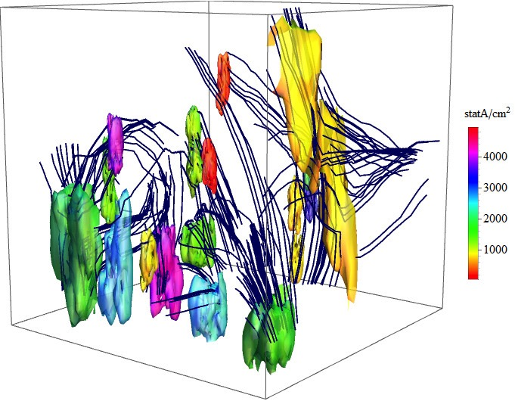
Based on the statistical properties of the distribution of current sheets we can follow the evolution of the particles (Vlahos, Isliker, Lepreti, Apj, 2004)
A particle travel a distance s_{i} losing energy by coulomb collisions. The distance s_{i} is estimated from the p(s) probability distribution.
Interact with the Current sheet and gaining energy
E is estimated from the current probability distribution p(j) and Δt is the acceleration time inside the volume V, which is estimated from the probability distribution p(V).

Slide 48
Generalize Fermi acceleration for spatially distributed accelerators

Slide 49
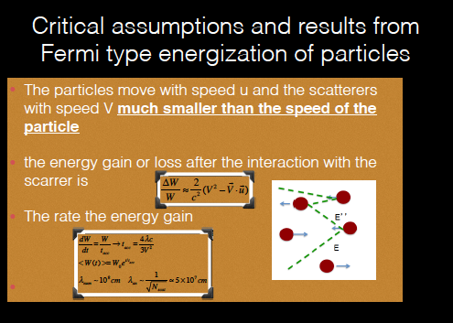

Slide 50




Fermi use the diffusion equation to reach his famous result
The diffusion coefficients are

Slide 51
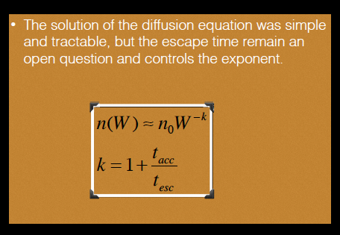

Slide 52

A lattice gas model for Fermi type heating / acceleration
We construct a 2D grid (NxN)
Each grid point is labeled with (i,j,k)
The (i,j) defines the spatial position of the grid and the k takes values (k=0) when the grid is empty and (k=1) when the grid is active
Only 1-10 % of the grid points are active.
When the particle (ion or electron) collides with an active point it changes it energy (depending on the local physics of the scatterer e.g. Alfven waves, current sheets, shocks) state and direction of travel inside the box
At time t=0 the particles are located at random points inside the grid and have random energies selected from a Maxwellian distribution n(W,t=0)

Slide 53
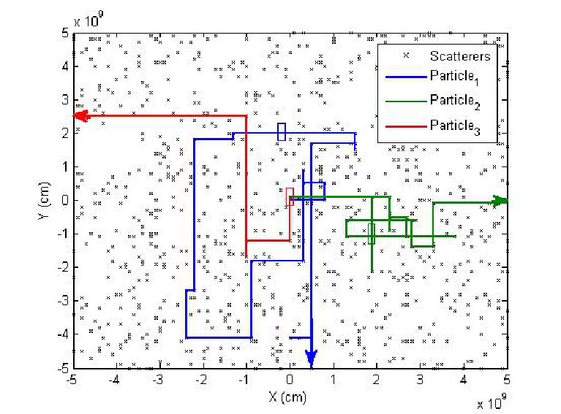
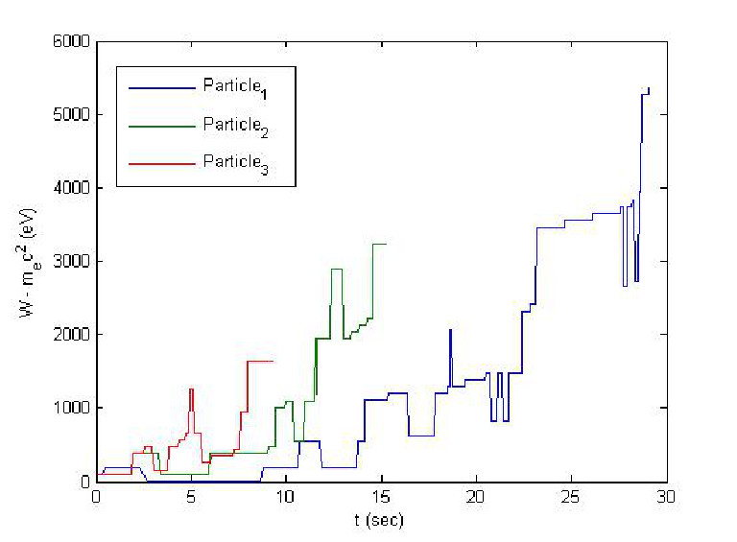
A lattice gas model for Fermi type processes

Slide 54
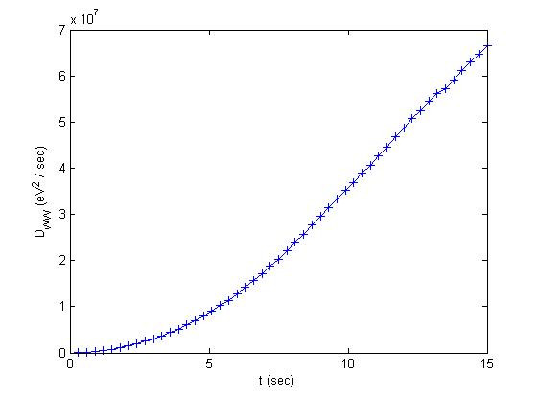


Statistical characteristics
We can estimate, based on the dynamics of the trajectories of the particles inside the lattice gas the diffusion and convection terms of the Diffusion equation

Slide 55
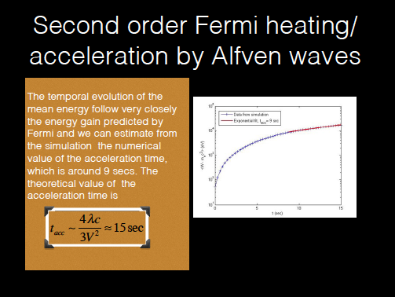

Slide 56
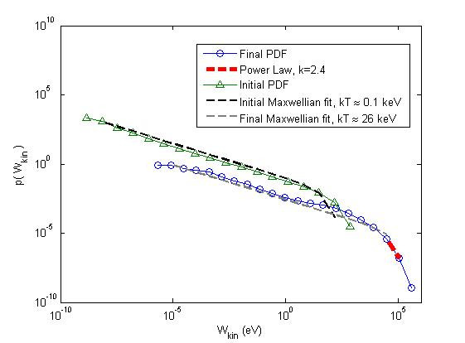


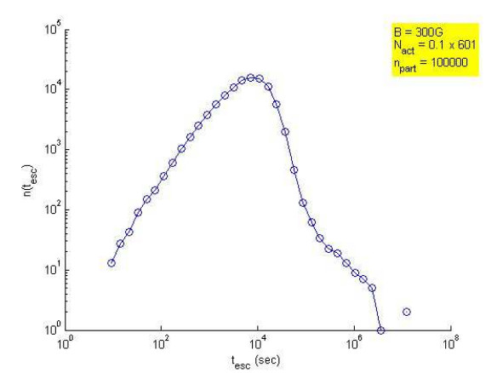
plasma heating and acceleration of the tail
Based on the data from our simulation the diffusion coefficient for coronal plasma dominates the convection term contrary to the initial assumption of Fermi, so the diffusion equation for the low energy particles

Slide 57
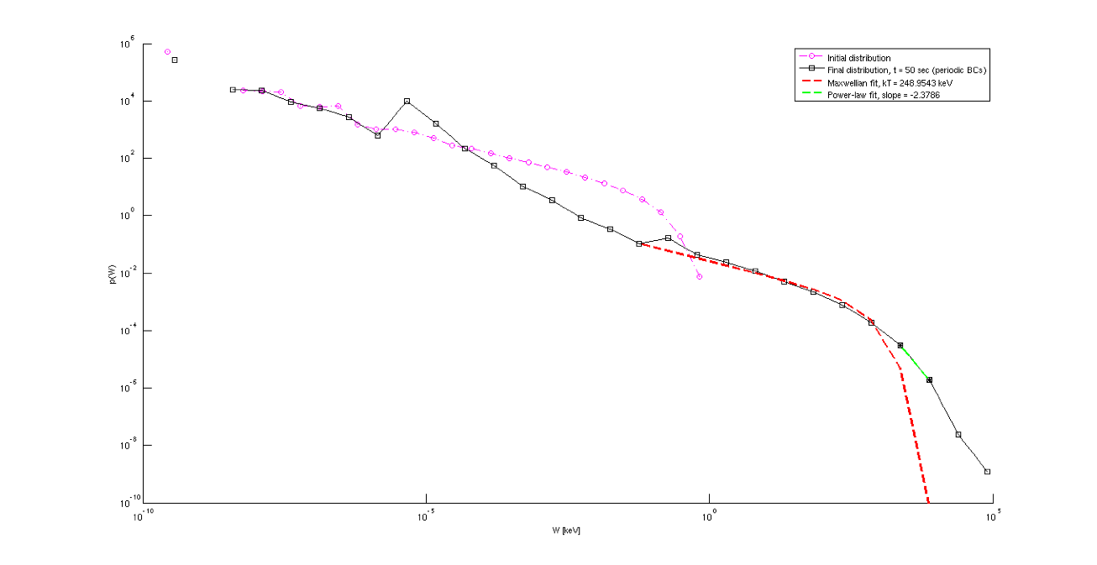

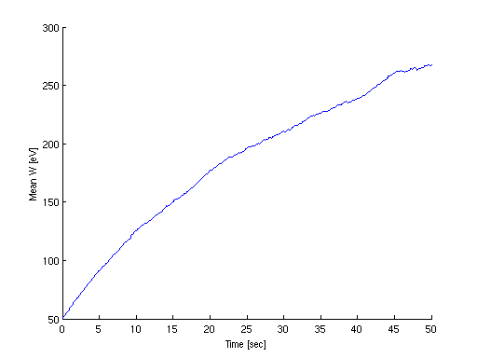
The “magnetic clouds” are replaced by Current sheets and first order fermi processes
the energy gain from the interaction of particles with a CS will be

Slide 58
Conclusions
The topic under consideration is intrinsically multiscale so in this presentation I used data from several types of numerical codes to prove my case, e.g.
3D Resistive MHD codes
Test particle codes and CTRW codes
Gyrokinetic codes
3D MHD +PIC codes
3D PIC codes
Diffusion Equation and more not mentioned in my talk

Slide 59
Main points from this presentation
MHD Turbulence are the natural way to form current sheets which reconnect and release energy (solar wind is one example)
Externally driven stressed magnetic topologies also form current sheets (convection zone-solar atmosphere are magnetically coupled)
Current sheets once they reconnect they initiate turbulence, as a dynamic feedback mechanism
The kinetic aspect of this process and particle heating and acceleration needs new tools and the revised Fermi process seems to work fine for the moment. Other tools like the probabilistic processes like the Continuous Random Walk are also used.

