Slide 1
Nonlinear Energetic Particle Transport in the Presence of Multiple Alfvénic Waves in ASDEX Upgrade and ITER
Mirjam Schneller

Slide 2
Acknowledgements
Ph. Lauber¹, S. Briguglio², A. Snicker^{3,1}
¹ Max-Planck-Institut für Plasmaphysik,
D-85748 Garching, Germany
² ENEA Centro Ricerche Frascati,
CP 65-00044 Frascati, Italy
³ Aalto University, Espoo, Finland
This work has been carried out within the framework of the EUROfusion Consortium and has received funding from the EURATOM research and training programme 2014-2018 under grant agreement No 633053. The views and opinions expressed herein do not necessarily reflect those of the European Commission.
The support from the EUROfusion Researcher Fellowship programme under the task agreement WP14-FRF-IPP/Schneller is gratefully acknowledged, as well as the collaboration within the EUROfusion Enabling Research project ENEA-03 (NLED).
The simulations of this work were partly run on HYDRA, Rechenzentrum Garching and HELIOS at IFERC, Japan. The computational resources as well as the support are gratefully acknowledged.

Slide 3
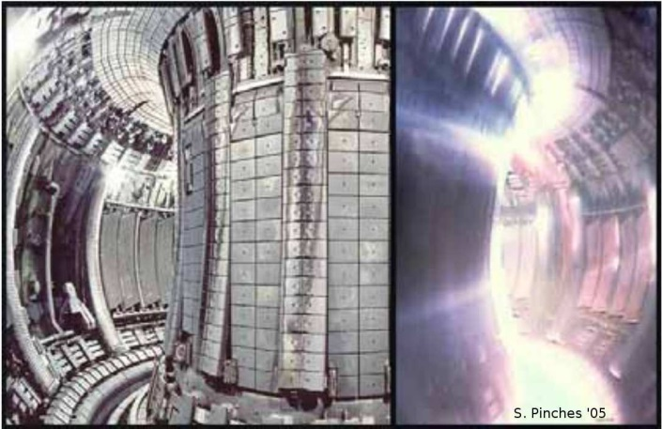
Why Investigate Energetic Particle-Alfvén Wave Interaction?
What physics can we learn?
resonance overlap
phase space structure formation
resonant or diffusive transport
← challenge: kinetic, nonlinear, multi-scale problem
→ relevance for astrophysical and fusion plasmas
Why study energetic particle (EP) - wave interaction in fusion plasmas?
EPs (v є [10keV ; 3.5MeV] >> v_{thermal}) such as fusion α-particles or fast ions generated by heating methods (NBI,ICRH) can provide ≤ 50% of pressure
→ EPs can interact with Alfvén instabilities
→ growth of waves & redistribution/loss of EPs
→ influence on confinement and fusion rate, possible damage of the wall.
EP – Alfvén wave interaction is studied experimentally:
measurement of distribution function, wave amplitudes & structures, EP losses
→ opportunity to validate models against observations

Slide 4
Outline
Why study Energetic Particle-Alfvén Wave Interaction?
Overview of the HAGIS-LIGKA Model
Numerical Investigation of EP Transport Mechanisms in ASDEX Upgrade
Nonlinear Energetic Particle Transport in the Presence of Multiple Alfvénic Waves in ITER
Conclusions and Outlook
[Study of Saturation Mechanisms with the ITPA n=6 TAE Benchmark Case]

Slide 5
2. The HAGIS-LIGKA Model
2.1 EP- Alfvénic Wave Energy Exchange
2.2 HAGIS-LIGKA Overview
2.3 HAGIS-LIGKA Advantages & Limitations

Slide 6
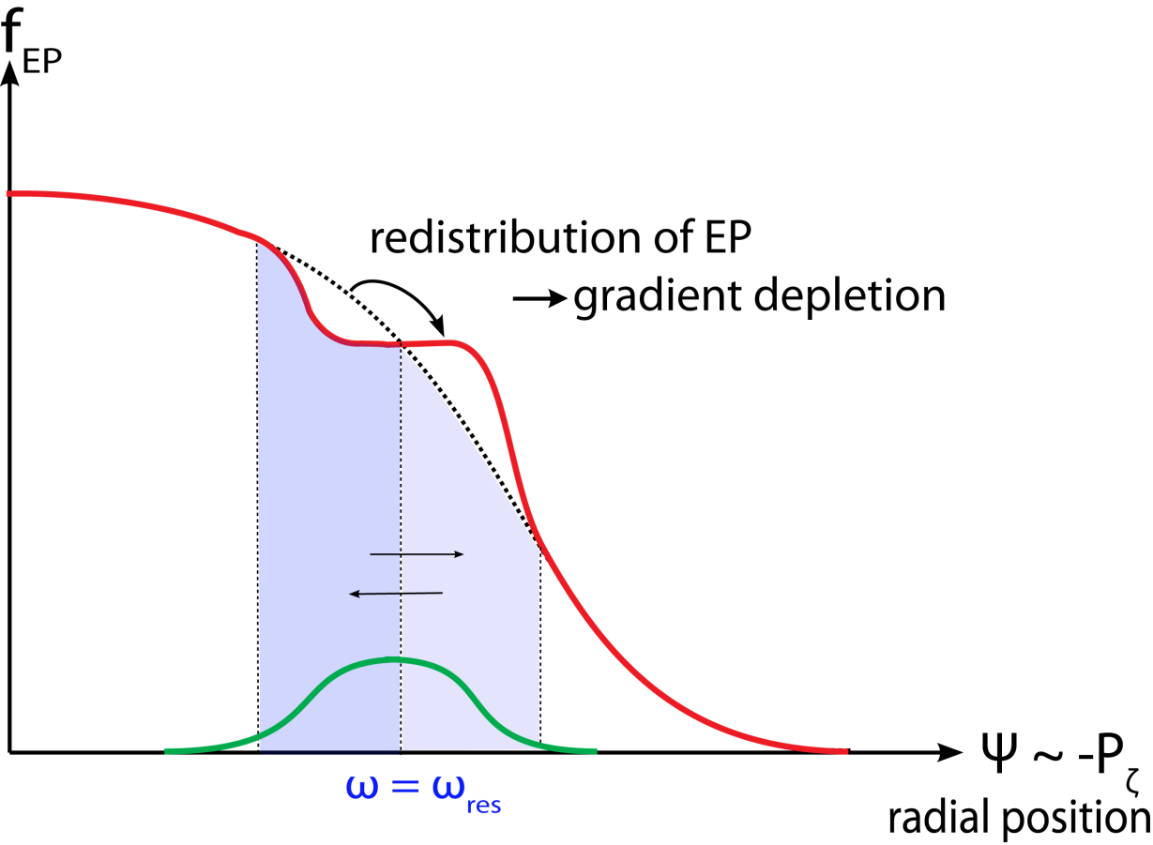
2.1 EP– Alfvénic Wave Energy Exchange
Energy exchange $δE ∝ \frac{∇ \left[\left(\frac{∂f}{∂E} − \frac{∂f}{∂Pζ}\right) ∙ φ \right]}{ω−ωres}$
Particles’ precession (drift) and bounce
frequencies can resonate w/ mode frequency:
$ω≈−nωD−[\left(nq−m\right)σ−p]ωb$ [Porcelli’94]
mag./el. field perturbation,
in this presentation:
Toroidicity-induced Alfvén Eigenmode (TAE) [Cheng’85] or Reversed Shear Alfvén Eigenmode (RSAE) [Berk’01]
Negative gradient in radial EP
distribution function leads to
mode drive by profile flattening
[Fu’89].
“ζ” denotes the toroidal angle,
“P_{ζ}” is the toroidal momentum.
[Candy’97]

Slide 7
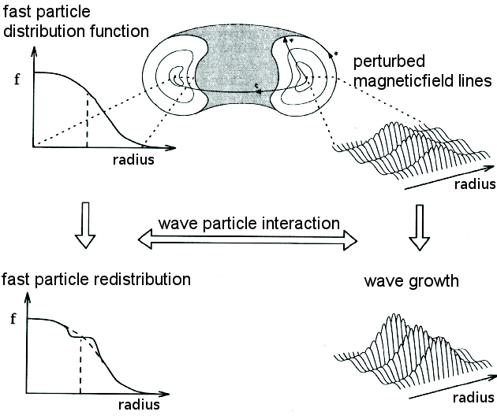
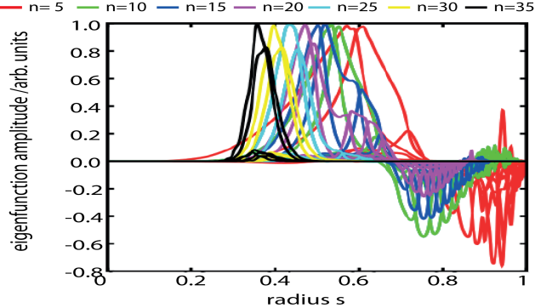
2.2 HAGIS-LIGKA Model: Overview
linear, global
gyrokinetic, non-perturbative
Eigenvalue solver
nonlinear, global, hybrid PIC
drift-kinetic, perturbative
vacuum region
New: multiple & passive species
LIGKA:
[Lauber’07]
HAGIS:
[Pinches’98]
“s” denotes the normalized poloidal flux

Slide 8
2.3 Model Advantages & Limitations
so far no mode structure evolution
→ ok if growth rates are small (near marginal stability)
no sink nor source
→ minor effect if stay well below slowing-down time
no toroidal mode-mode coupling: no zonal (n=0) and higher n sidebands (would be stabilizing)
separable distribution function f(s)·f(E)·f(λ)
hybrid → reduced computational effort
→ flexible (how many modes, harmonics,…)
LIGKA: gyrokinetic, non-perturbative effects
for damping and mode structure (differs from MHD)
global modes (non-local effects: see later!)

Slide 9
3. Numerical Investigation of EP Transport Mechanisms in ASDEX Upgrade
1. Experimental Observations
2. Basic Numerical Study
3. More Realistic Modeling
4. Numerical vs. Experiment

Slide 10
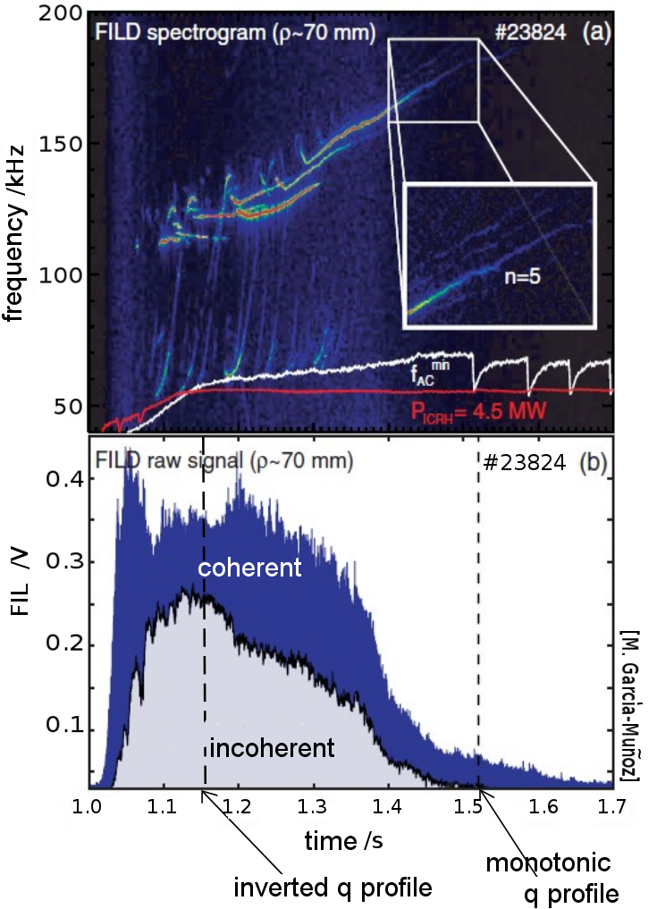
3.1 ASDEX Upgrade Observations [García-Muñoz’10]
ICRH-heated ASDEX Upgrade discharge #23824:
Measurements at Fast Ion Loss Detector (FILD):
Strong temporal variation of loss signal:
total amount of EP losses
classification of losses:
coherent = convective, $∝$ (δB/B),
w/ correlation to mode/beat freq.
$\text{in}\text{coherent} \text{= }\text{diffusive}\text{,}∝$ (δB/B)²
w/o correlation to mode/beat freq.
What is the reason for the incoherent losses?
prompt losses (= unconfined orbits)?
mode stochastizitation → cause, precondition?

Slide 11
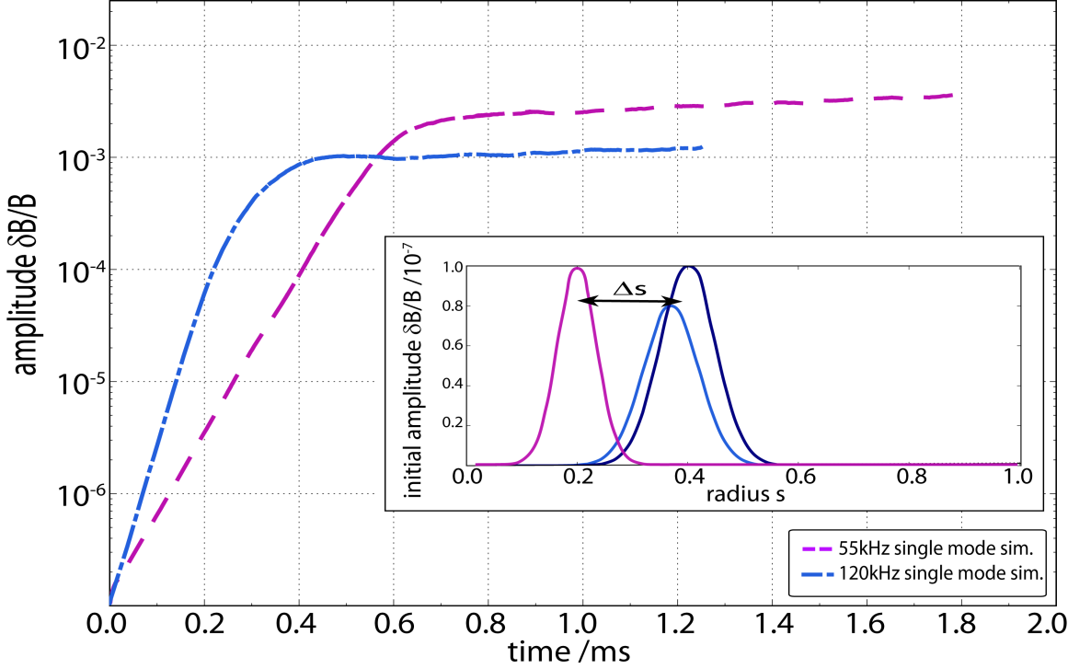
3.2 Basic Numerical Study
Two modes seen in experiment:
TAE (120kHz) and RSAE (55kHz)
analytical mode structures
simplified distribution function
frequencies from experiment

Slide 12
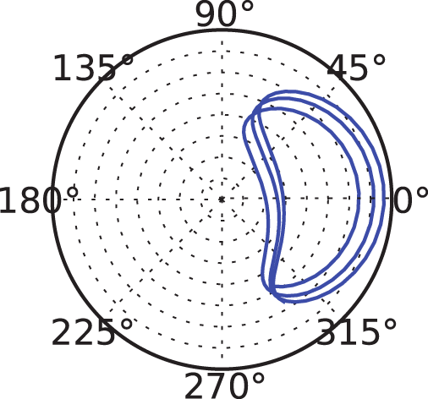
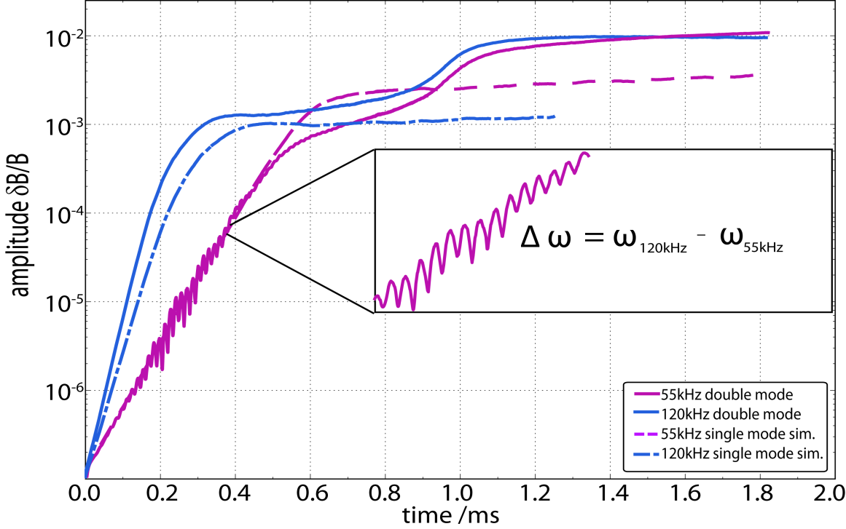
3.2 Double mode-EP interaction
Two modes seen in experiment:
TAE (120kHz) and RSAE (55kHz)
Particle orbit (s-θ space) during resonant phase
Particle orbit (s-θ space) during stochastic phase
Double-mode resonance [Schneller’12]:
superimposed oscillation (with beat frequency)
larger growth rate for at least one mode
saturation level: more likely to reach stochastic regime
(but depends on Δs, can also be lowered)

Slide 13
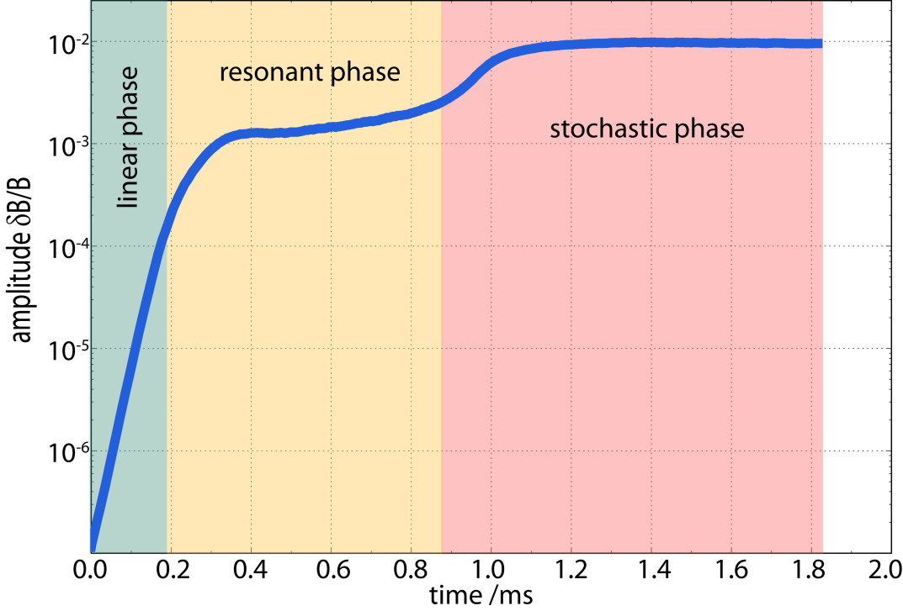
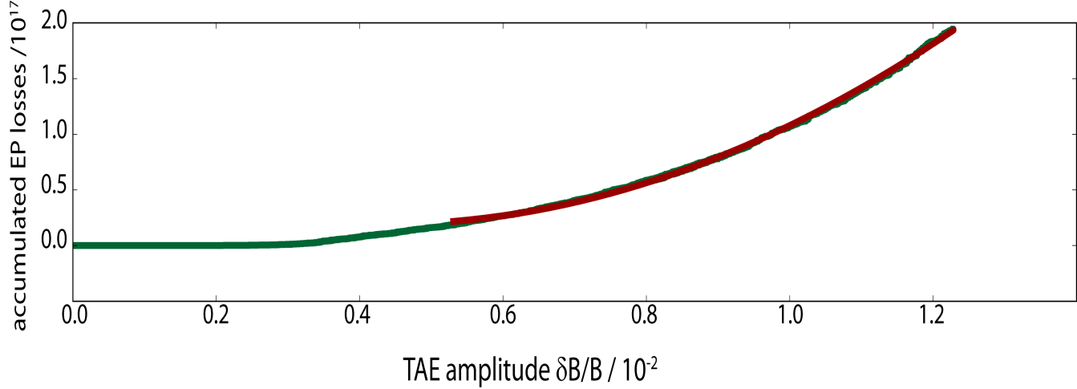
3.2 Resonant vs. stochastic mode regime
Different phases – different losses:
diffusive losses α (δB/B)² – theory [Sigmar’92]
losses correlated with

Slide 14
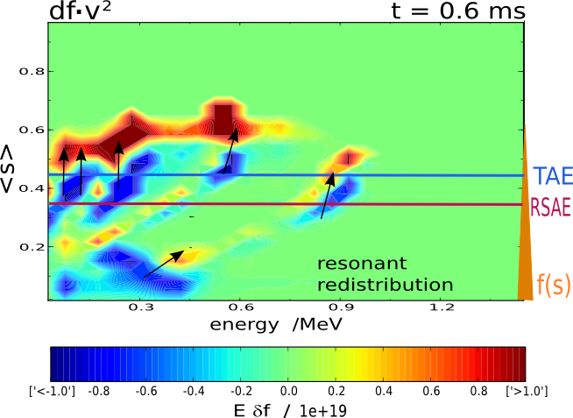
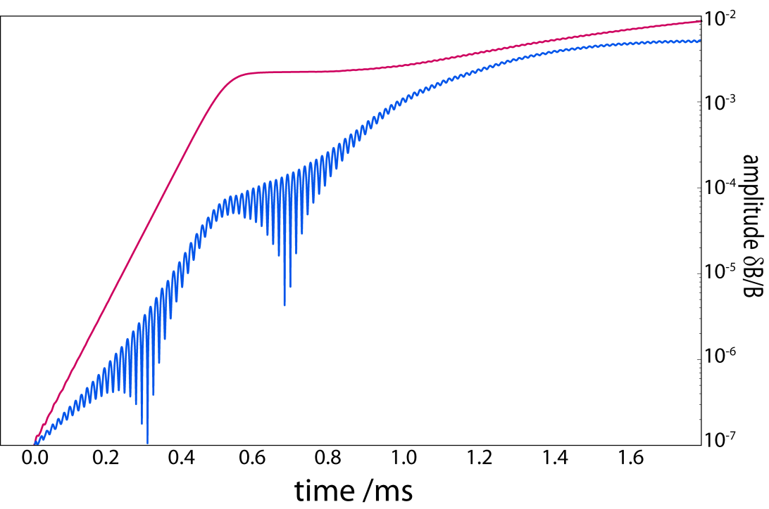
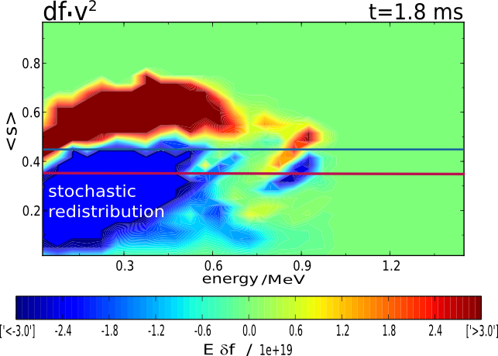
3.2 Resonant vs. diffusive transport
different regimes:
resonant redistribution
phase space stochastization

Slide 15
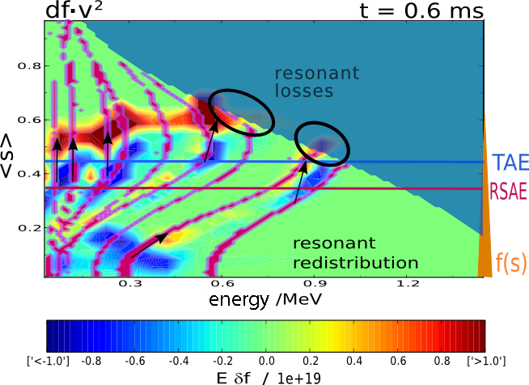
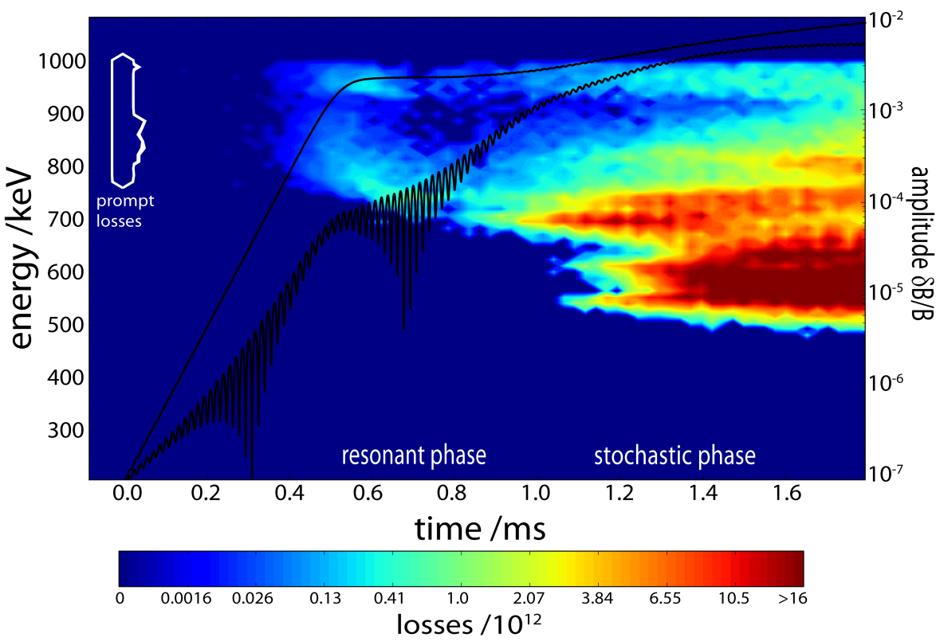
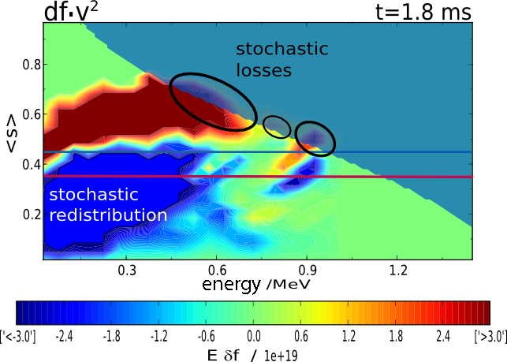
3.2 Resonant vs. diffusive transport
different regimes:
resonant redistribution → resonant losses
phase space stochastization→ diffusive losses
stochastic regime likely to be reached (only) in
multi mode scenario

Slide 16
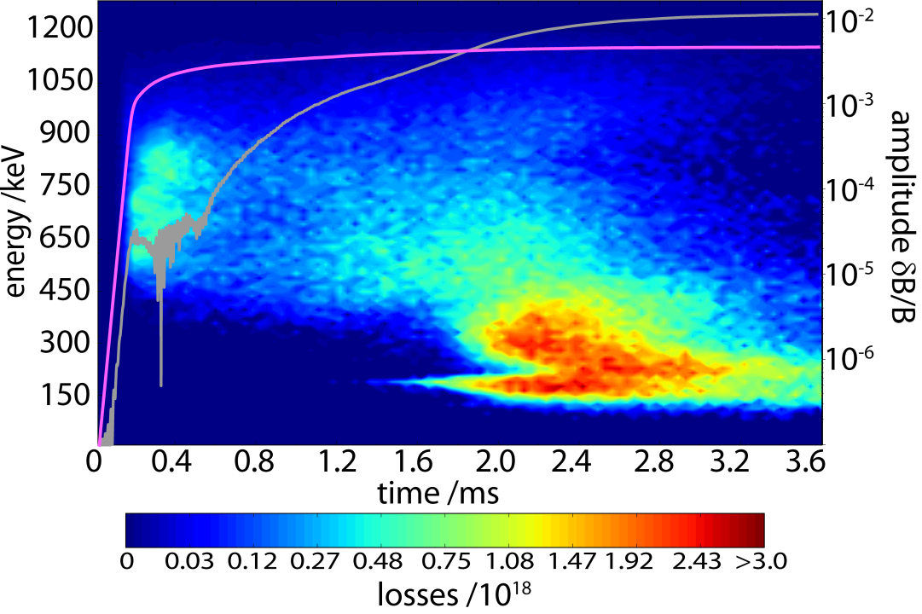
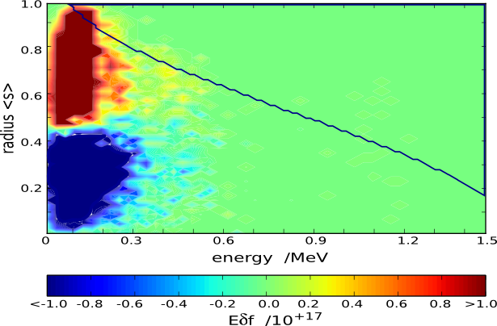
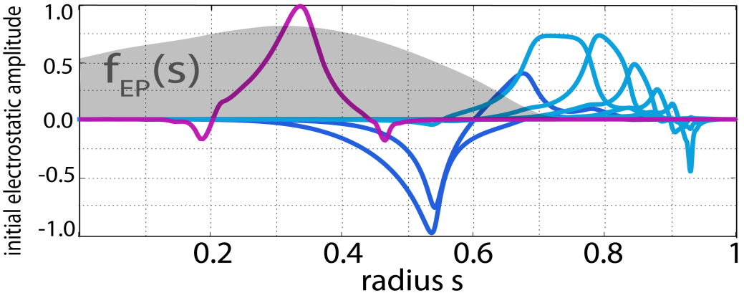
3.3 More realistic Modeling: “Domino” effect
More realistic HAGIS:
ICRH distribution function consistent in velocity space
LIGKA eigenmodes
(including Re & Im part).
experimentally found losses:
down to 1/10 of birth energy

Slide 17
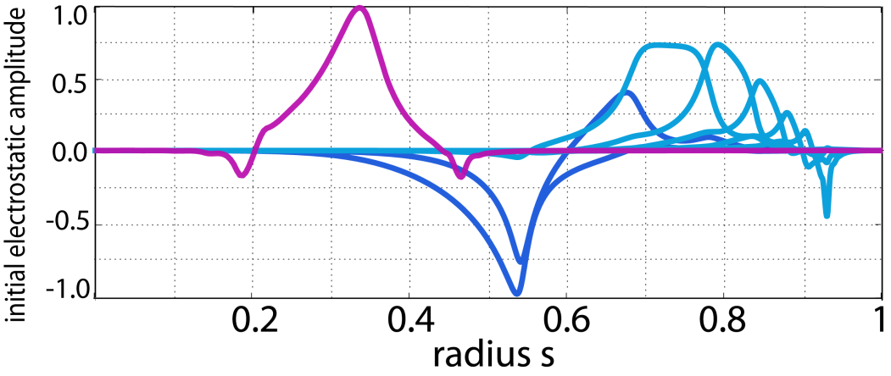
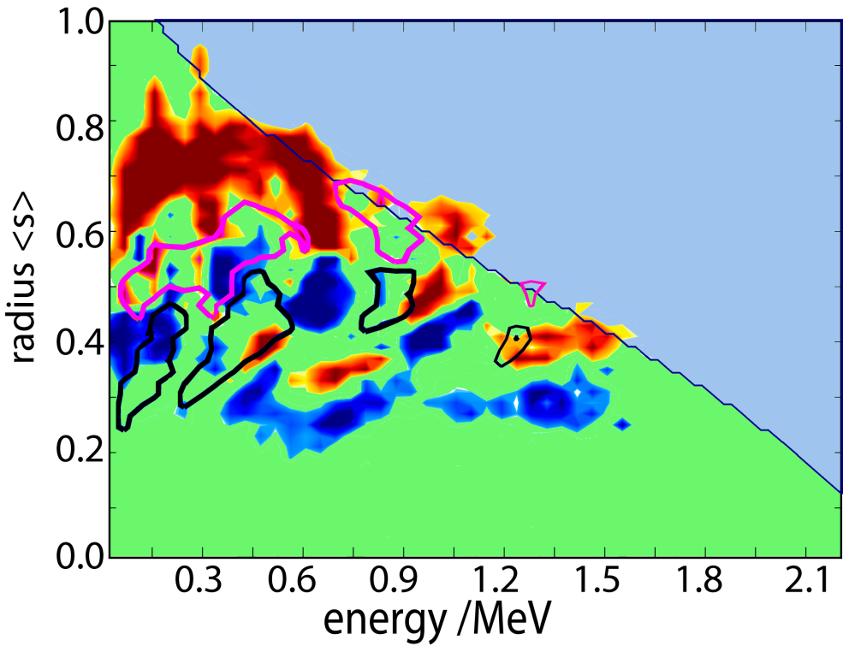
3.3 More realistic Modeling: “Domino” effect
as 2 single modes (fixed amplitude)
multi mode scenario, many harmonics → domino effect [Berk’95]
→ diffusive & enhanced losses
as measured [García-Muñoz’10]
at ASDEX Upgrade.

Slide 18
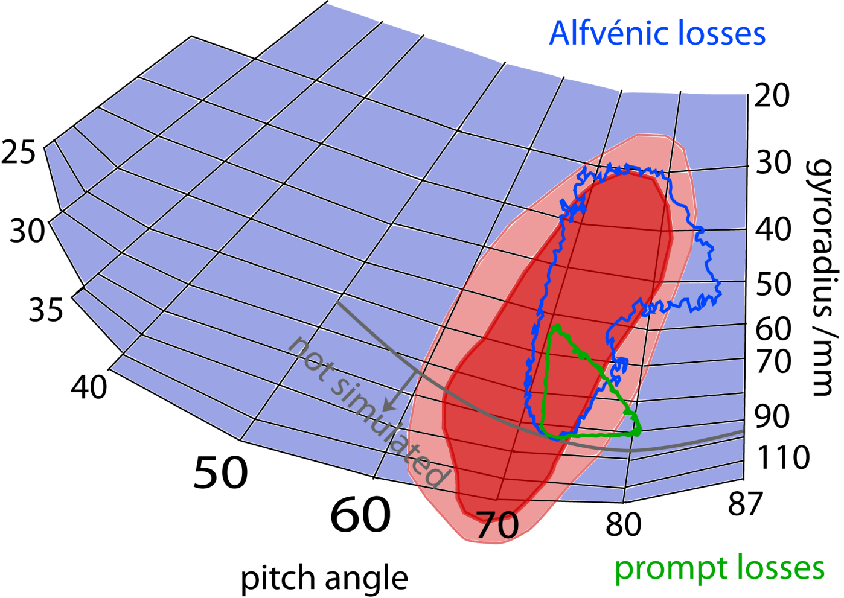
3.3 ASDEX Upgrade: numerical vs. experiment
Experimentally found EP losses in ASDEX Upgrade #23824, t=1.16s at the FILD [García-Muñoz’10]: red area
diffusive losses due to
“domino effect” (incoherent)
Losses during inverted q profile (shown here), which leads to more losses due to wider orbits compared to the monotonic q profile (not shown in this presentation).
Simulated EP losses with HAGIS-LIGKA [Schneller’13]: green and blue boundaries.
(incoherent)
resonant losses (coherent)

Slide 19
4. Nonlinear Energetic Particle Transport
in the Presence of Multiple Alfvénic Waves in ITER
1. Motivation and Challenges
2. Setup for the ITER 15MA Baseline Scenario
3. Linear Findings
4. Quasi-linear Model
5. Nonlinear Findings with reduced Damping
6. Nonlinear Findings with LIGKA Damping

Slide 20
4.1 Do we need a nonlinear description?
In certain ITER scenarios, a “sea” of small-amplitude perturbations is likely [Gorelenkov’14,Lauber’15]. Can energetic particle interaction with multiple modes drive linearly stable or weakly unstable modes nonlinearly unstable?
if YES → possible enhanced nonlinear EP transport
due to a “domino effect”
If NO → EP transport could be estimated on a local, quasi-linear basis
which is computationally advantageous [Bass’10, Ghantous’12]
the ITER scenario is too challenging to be tackled with a comprehensive (non-hybrid, nonlinear) code.
previous simulations with our hybrid model for ASDEX Upgrade revealed such “domino” behavior [Schneller’2013], in agreement with EP loss measurements [García-Muñoz’2010].

Slide 21
4.1 Challenges of the ITER Scenario
more than 25 toroidal modes
big machine (R=6.21m, a=2.0m), small modes (n ϵ [5,35])
many poloidal harmonics
small drive (near marginal stability)
→ high resolution needed (up to 20 mio. markers)
convergence tested
→ long simulation time (up to > 5ms)
still well below (2%) slowing down time
1024 CPU for several days (on HYDRA and HELIOS)

Slide 22
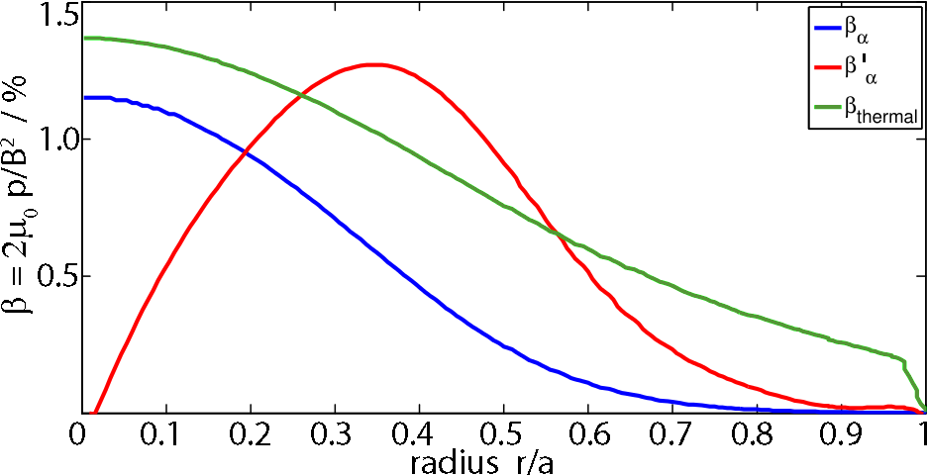
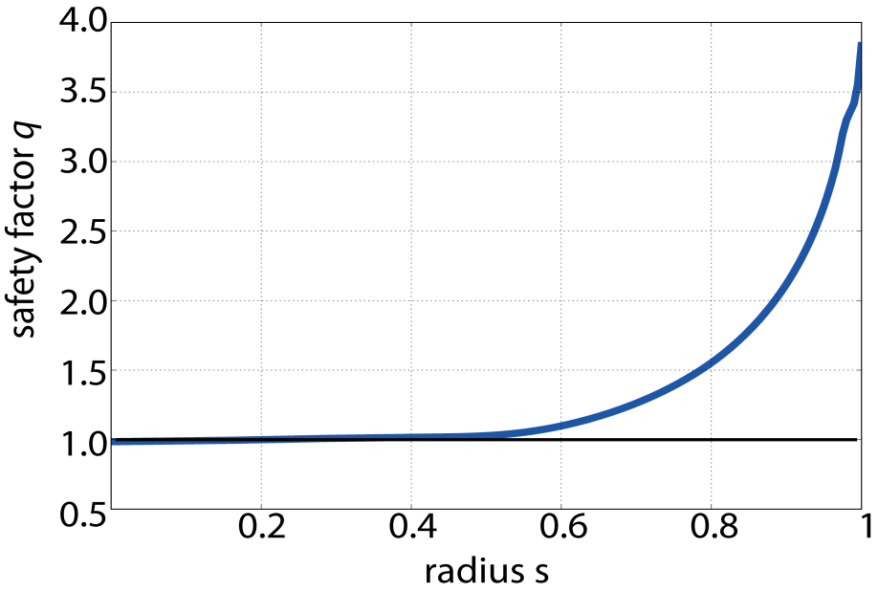
4.2 Setup for ITER 15 MA Baseline Scenario
1:1 D-T plasma with β_{th} ≈ 1.3%,
B_{mag} = 5.3 T
The q profile is rather flat, close to 1
(q₀=0.989) and monotonic
(← worst ITER case [Polevoi’02,Pinches’15])
[Polevoi’02 ,
Pinches’15]
EP: Fusion-born α-particles with β_{EP} ≈ 1.2% (so far no beam EP),
isotropic in pitch, follow the slowing-down energy distribution:

Slide 23
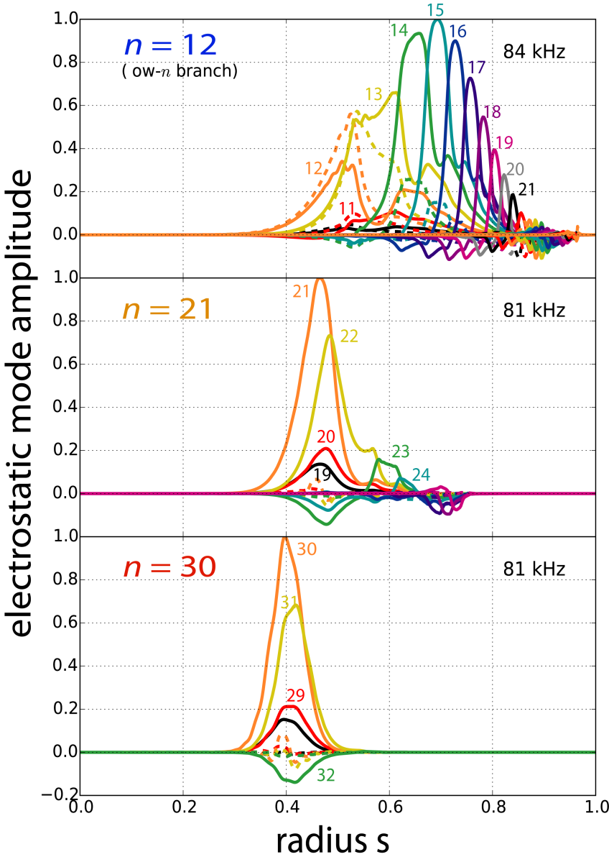
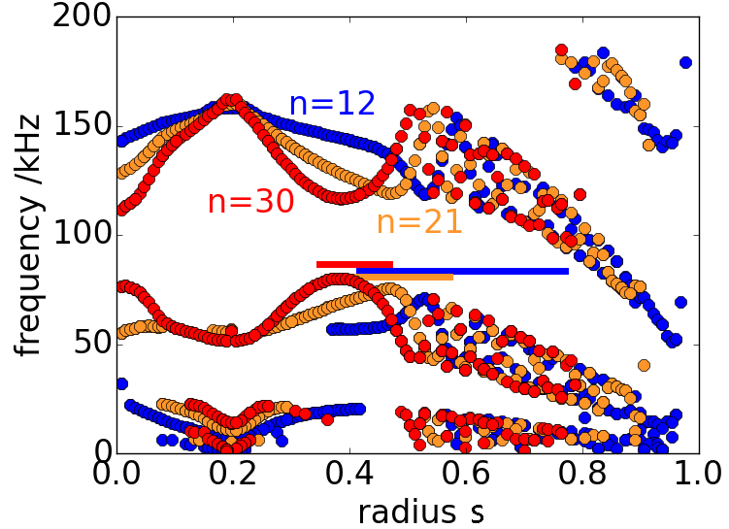
4.3 Linear Findings: continuum & wave structures [Lauber’15]
The Shear-Alfvén Wave continuum: flat shear enables a broad TAE cluster around r ≈ 0.4
many poloidal harmonics especially for low n.
with increasing n modes become radially more localized & mode position moves towards core
kinetic SAW: differs from ideal SAW –
kin. effects generally decrease damping
Non-perturbatively calculated structures (incl. kin. effects)
Notes:
Gaps are wide because of low-shear and flat background density.
Frequencies in the middle of the gap due to non-perturbative effects (/= MHD result!)

Slide 24
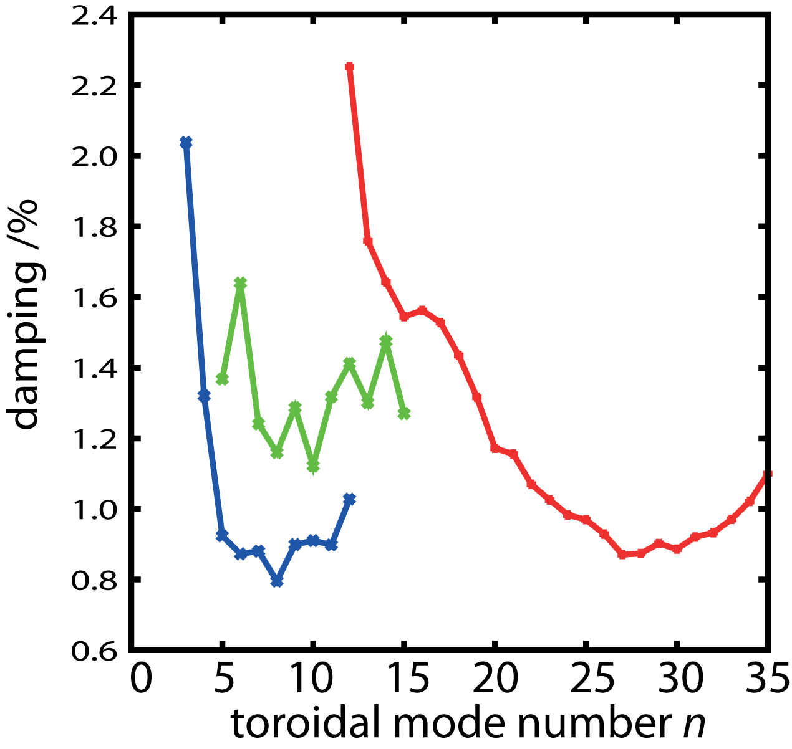
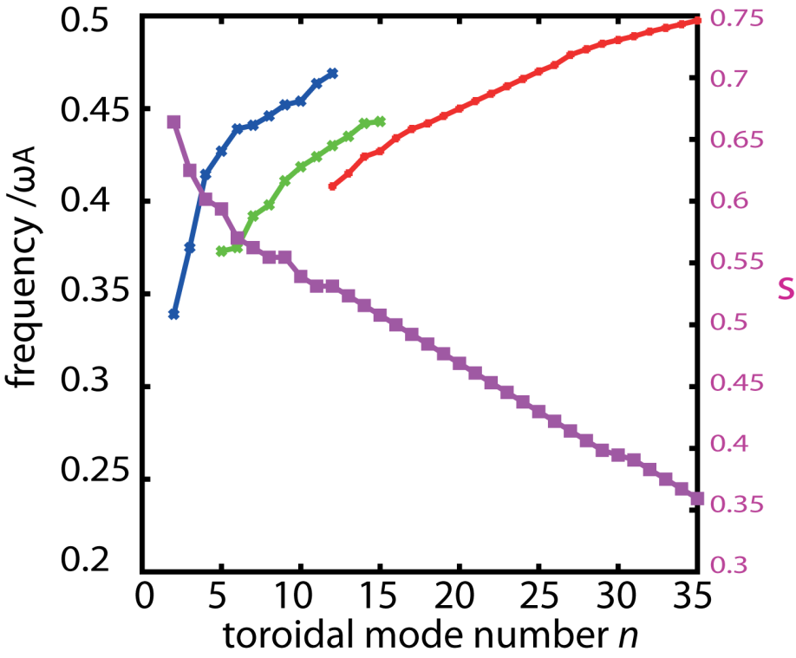
4.3 Linear Findings: TAE Eigenvalues [Lauber’15]
several branches found, according
to main harmonics:
m = n + {0,1}
m = n + {1,2}
m = n + {2,3}
lowest damping ɣ_{d} around n ≈ 26 and in low-n branch.
largest linear mode drive ɣ_{L} by EP for $n ∈[20,30]$ around 3.5%
← in agreement with analytical theory $k⊥ρi ≈1$ [mode width ≈ orbit width]
← in agreement with CASTOR-K findings [Rodrigues‘15]
← found by both LIGKA and HAGIS, except for missing FLR (damping) effects in HAGIS.
low-n are marginally stable in single mode case: ɣ_{L} < 1%
ɣ := ɣ_{L} - ɣ_{d}
ω_{A} := v_{A}/R_{mag} = 178 kHz
[ɣ]% := [ɣ]1/s / [ω]rad/s
Notes:
Reasons for low damping:
low-n branch: amplitudes of pol. harmonics are low, therefore weak continuum damping;
high-n branch: high frequencies lead to low ion Landau damping, low shear leads to low radiative damping.

Slide 25
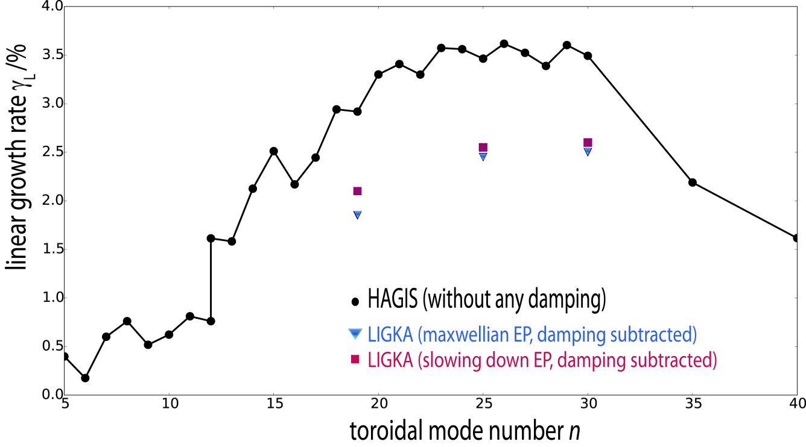
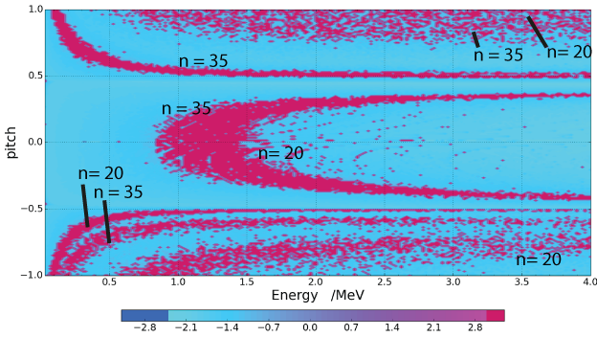
4.3 Linear Findings: Drive & Resonances
Largest linear mode drive between n = 20 and 30
For low-n, ɣ < 1%
HAGIS slightly overestimates drive due to missing FLR effects
Phase space resonance areas are broad and overlapping
Notes:
Reasons for drive:
k_theta * banana-orbit = 1,
high EP density gradient

Slide 26
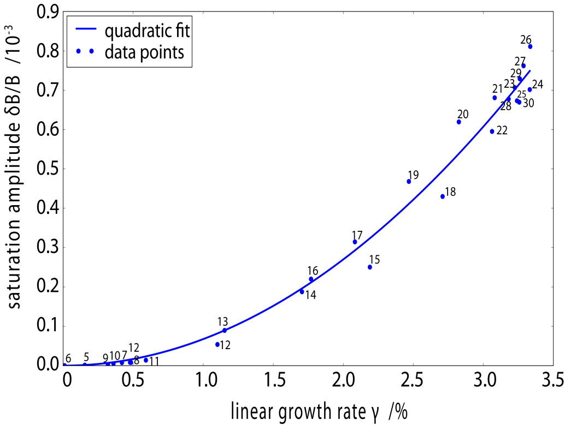
4.4 “Quasi-linear” Approach [e.g. Gorelenkov’14] to predict EP transport for given EP density profile
Determine scaling of linear growth ɣ $∝$ β (EP density)
from single mode simulations → know β_{crit} = β (ɣ ≈ 0) for every mode
saturation amplitude estimated via A $∝$ (ɣ/ω)²
or from experiment (e.g. DIII-D [Ghantous’12])
QL approach assumes that transport is diffusive, if $\text{β}≥\text{β}\text{cri}\text{t}$
→ δ –function is broadened [Dupree’66],
in this model: by finite ɣ
→ in multi mode scenarios with over-
lapping resonances, D is asssumed
a constant in phase space.
Scaling of amplitude vs. gamma: quadratic (only) in single mode simulations, here for ITER case with default EP density with negligible damping.
Notes:
Plotting tool: fit_gammaamp_damp.py

Slide 27
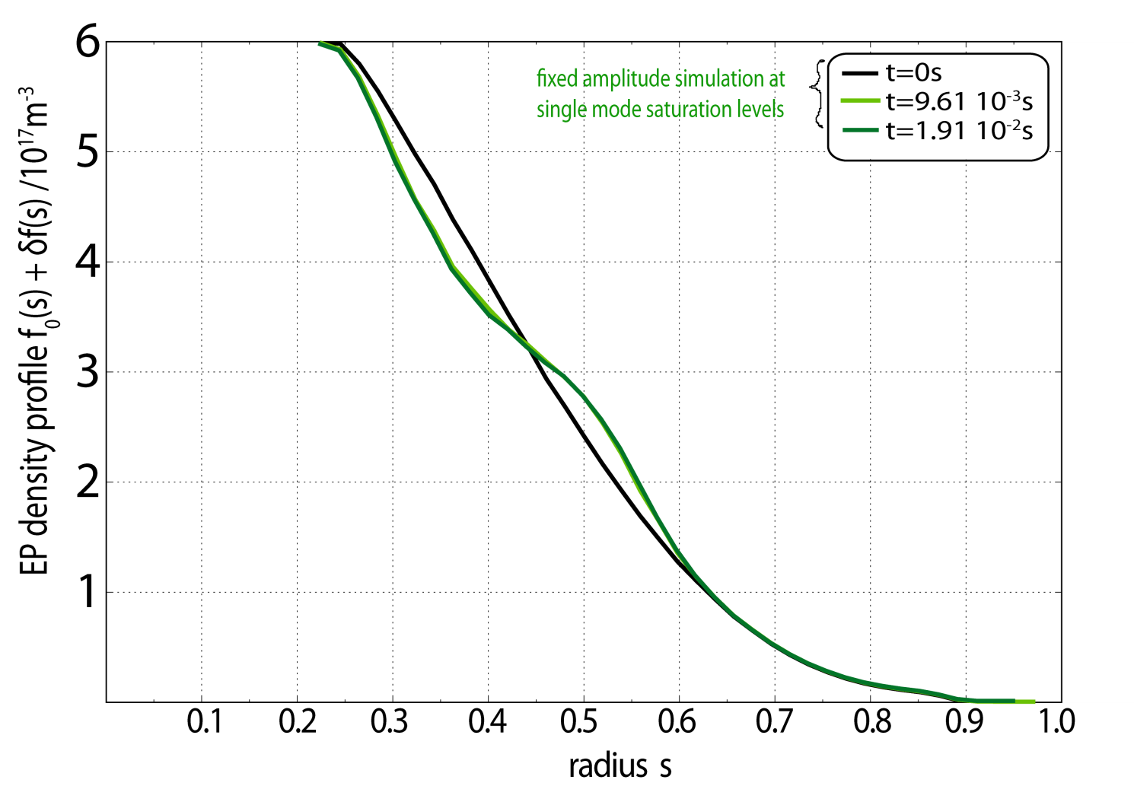
4.4 Quasi-linear Redistribution
Multi mode simulation with fixed amplitudes at the values obtained from single mode simulation (= “quasi-linear” (QL) simulation):
Here: negligible damping was applied.

Slide 28
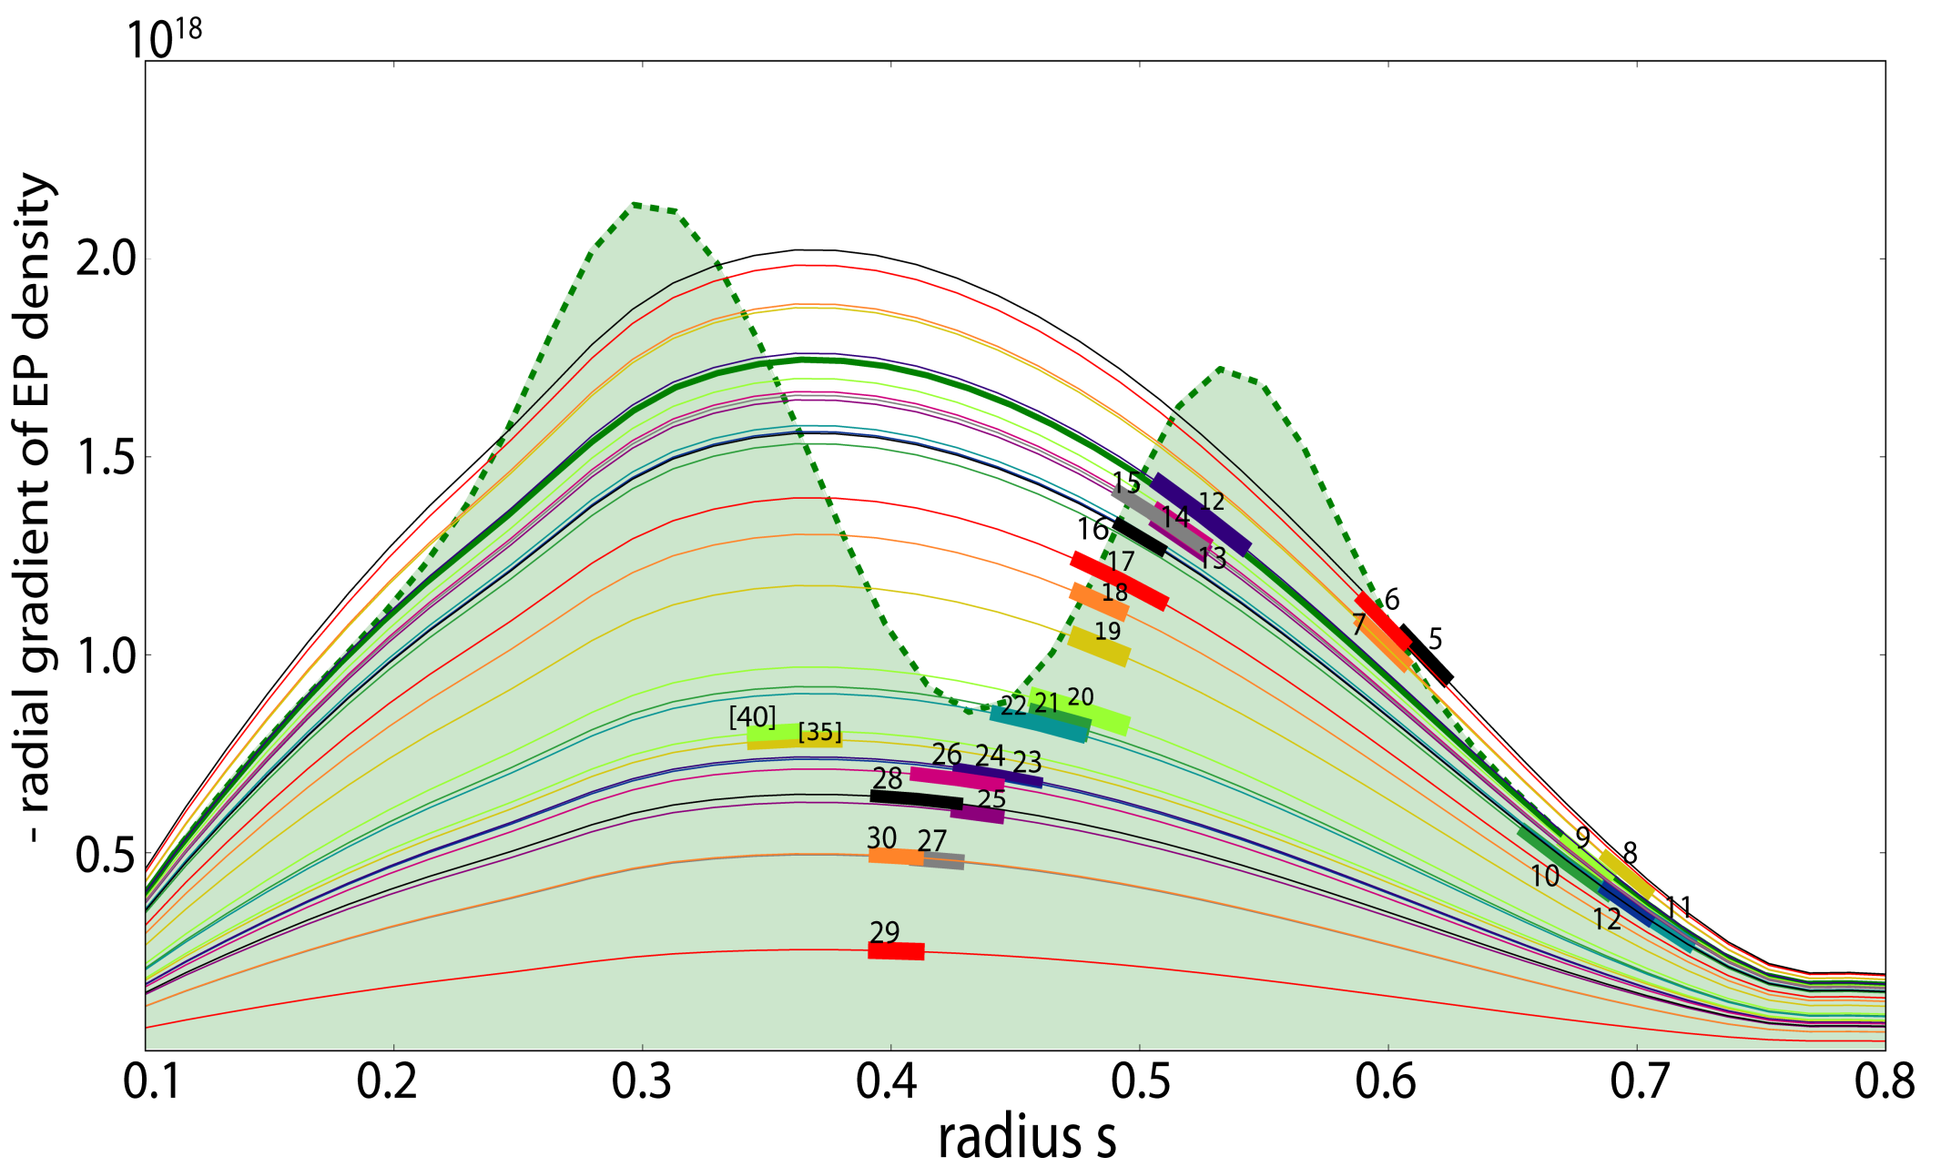
4.4 Quasi-linear Redistribution
initial
final
gradient of
β scaled to $βcrit$(n) at mode n ‘ s position (thick)
Notes:
This data is from ITER_15MA_2014 run 206 (redistribution=green) and runs in folder “betascaling” (beta_crits=red dots); tool to plot: plot_radial_betacrit_diffQL.py

Slide 29
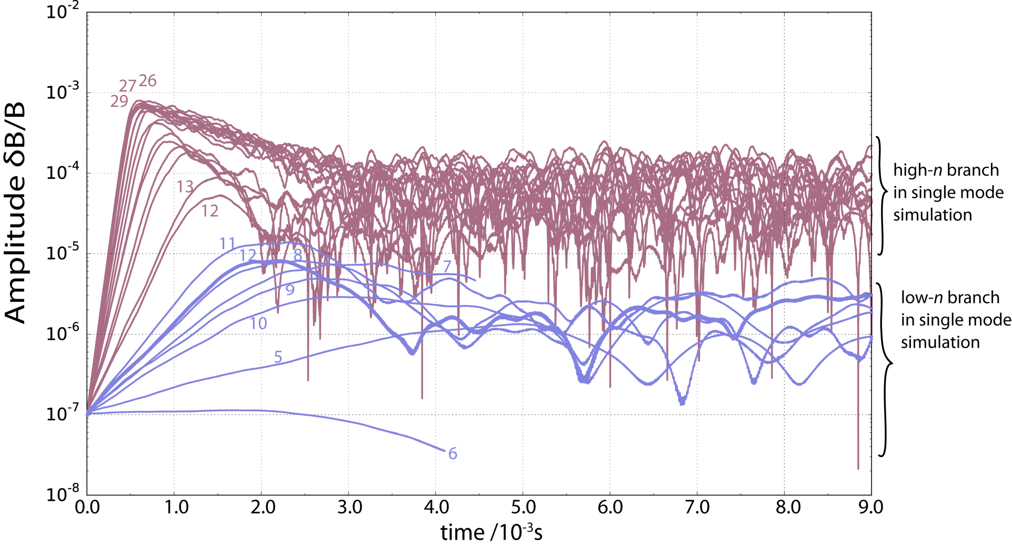
4.5 Nonlinear Findings: Growth & Amplitudes
Multi v.s. single mode case (default EP density profile, damping reduced by a factor of 6): n=5..12, n=12..30
Notes:
This is from ITER_15MA_2014 runs: 162, 150-59,171-178,184-192

Slide 30
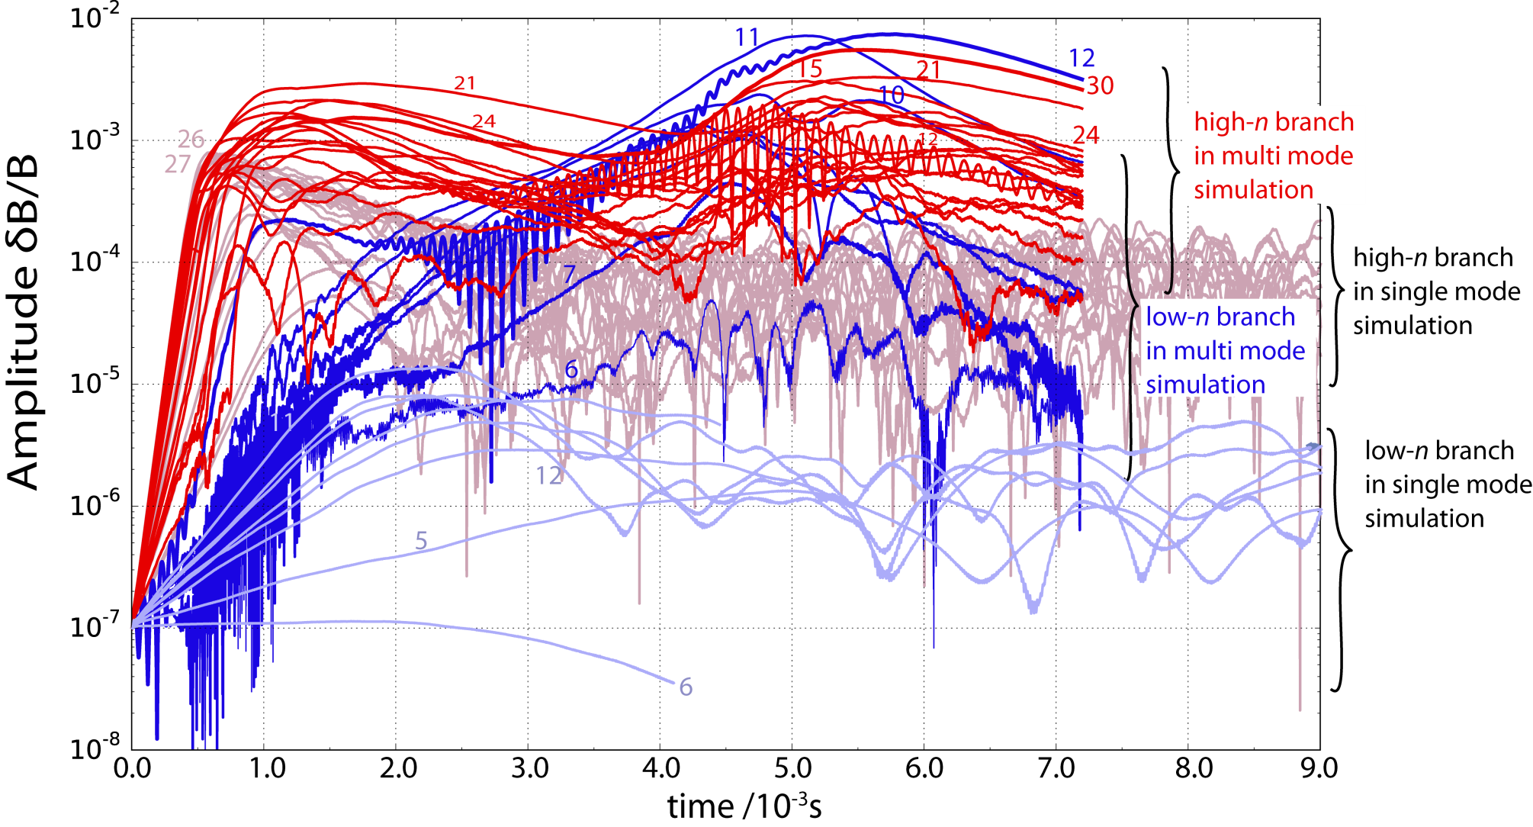
4.5 nonlinear Findings: Growth & Amplitudes
Multi v.s. single mode case (default EP density profile, damping scaled to negligible values): n=5..12, n=12..30
Notes:
This is from ITER_15MA_2014 runs: 162, 150-59,171-178,184-192

Slide 31
4.5 nonlinear Findings: Growth & Amplitudes
Comparison multi v.s. single mode scenario:
early linear growth rates comparable for the low-n branch (ratio 1±0.6),
similar for the high-n branch (ratio 1±0.1),
big difference in the nonlinear behavior:
low-n branch reaches amplitudes up to x60 higher
and n=12,11,10 become (partly) dominant
high-n branch reaches a 2nd saturation level (up to x10 higher)
interesting dynamics: modes reach high amplitude regimes
at very different times t: growth of the low-n branch in 3 phases:
t < 0.4ms: like single mode
0.4ms < t < 3.0ms: enhancement until almost “saturation”
t > 3.0ms: 2nd enhancement
followed by 2nd enhancement of high-n modes at around t ≈ 4.5ms.
global, multi mode effect: strong additional excitement (in later nonlinear phase) not possible with reduced scenario of 8 strongest & broadest modes
(n=8; 11; 12 (low-n); 12; 18; 21; 24; 30)

Slide 32
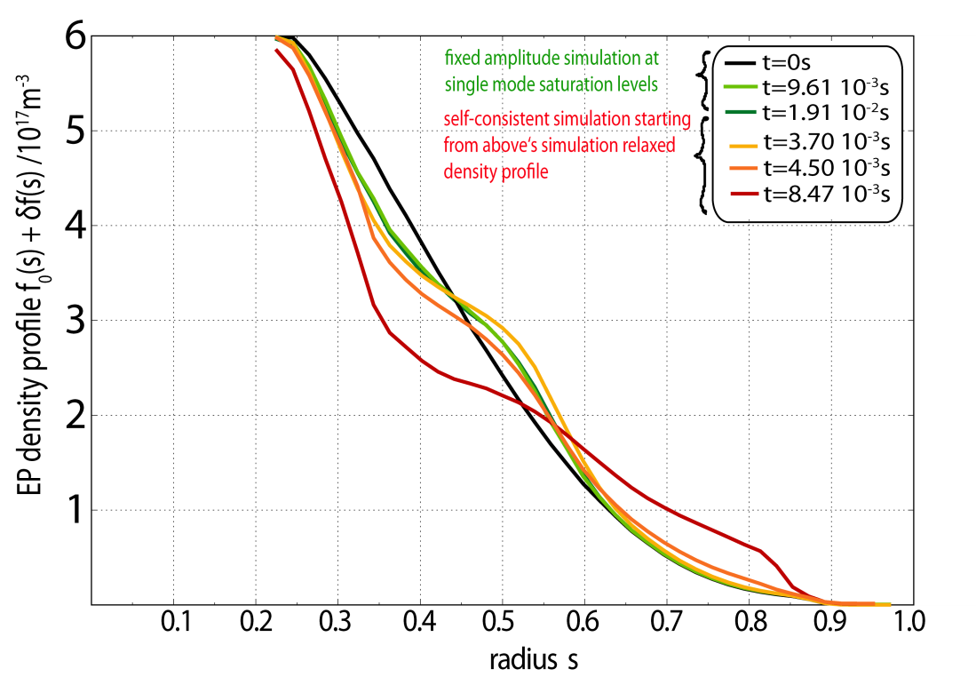
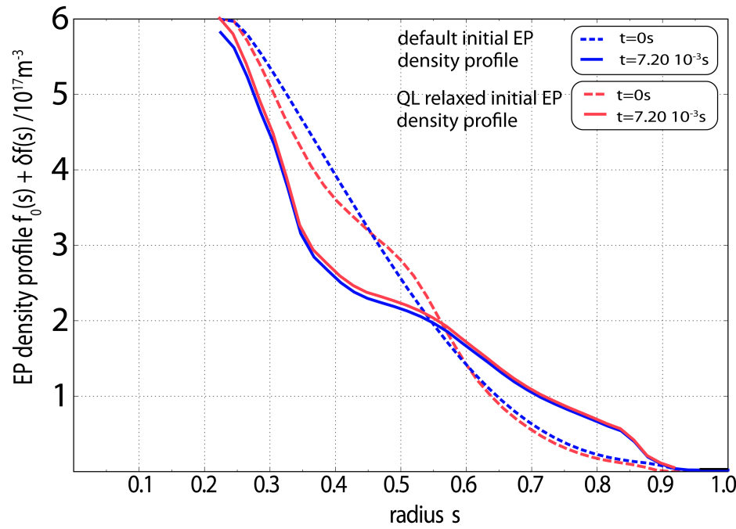
4.5 Nonlinear Redistribution
multi mode radial redistribution in self-consistent mode evolution
much higher than in QL multi-mode simulation;
striking: outer redistribution triggered out to $s ≈0.85$(left fig.)
even if initial EP profile is relaxed already, self-consistent multi mode simulation reveals large & outer redistribution
in reduced scenario (n=8; 11; 12; 12; 18; 21; 24; 30) no outer redistribution

Slide 33
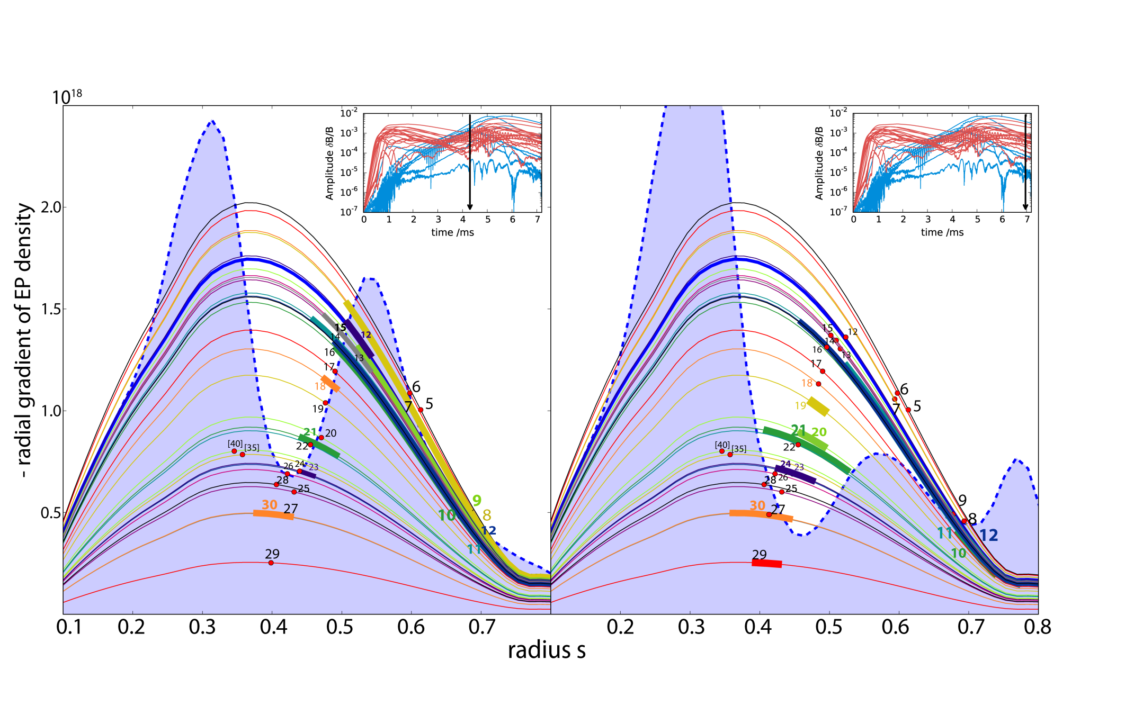
4.5 Nonlinear Radial Transport
global approach needed:
modes can be driven in the core,
but redistribute near the edge
Thick colored: width of mode (δB/B>10⁻³)
Notes:
This data is from ITER_15MA_2014 run 241 (redistribution=blue) and runs in folder “betascaling” (beta_crits=red dots): plot_radial_betacrit_diff2NL.py. The width of the modes (thicker parts of lines) is obtained from HAGIS_DIAG.py -> mode.py -> Plot_2Ddata_sth

Slide 34
4.5 QL v.s. Nonlinear Radial Transport
Notes:
This data is from ITER_15MA_2014 run 241 (redistribution=blue) and runs in folder “betascaling” (beta_crits=red dots): plot_radial_betacrit_diff2NL.py. The width of the modes (thicker parts of lines) is obtained from HAGIS_DIAG.py -> mode.py -> Plot_2Ddata_sth

Slide 35
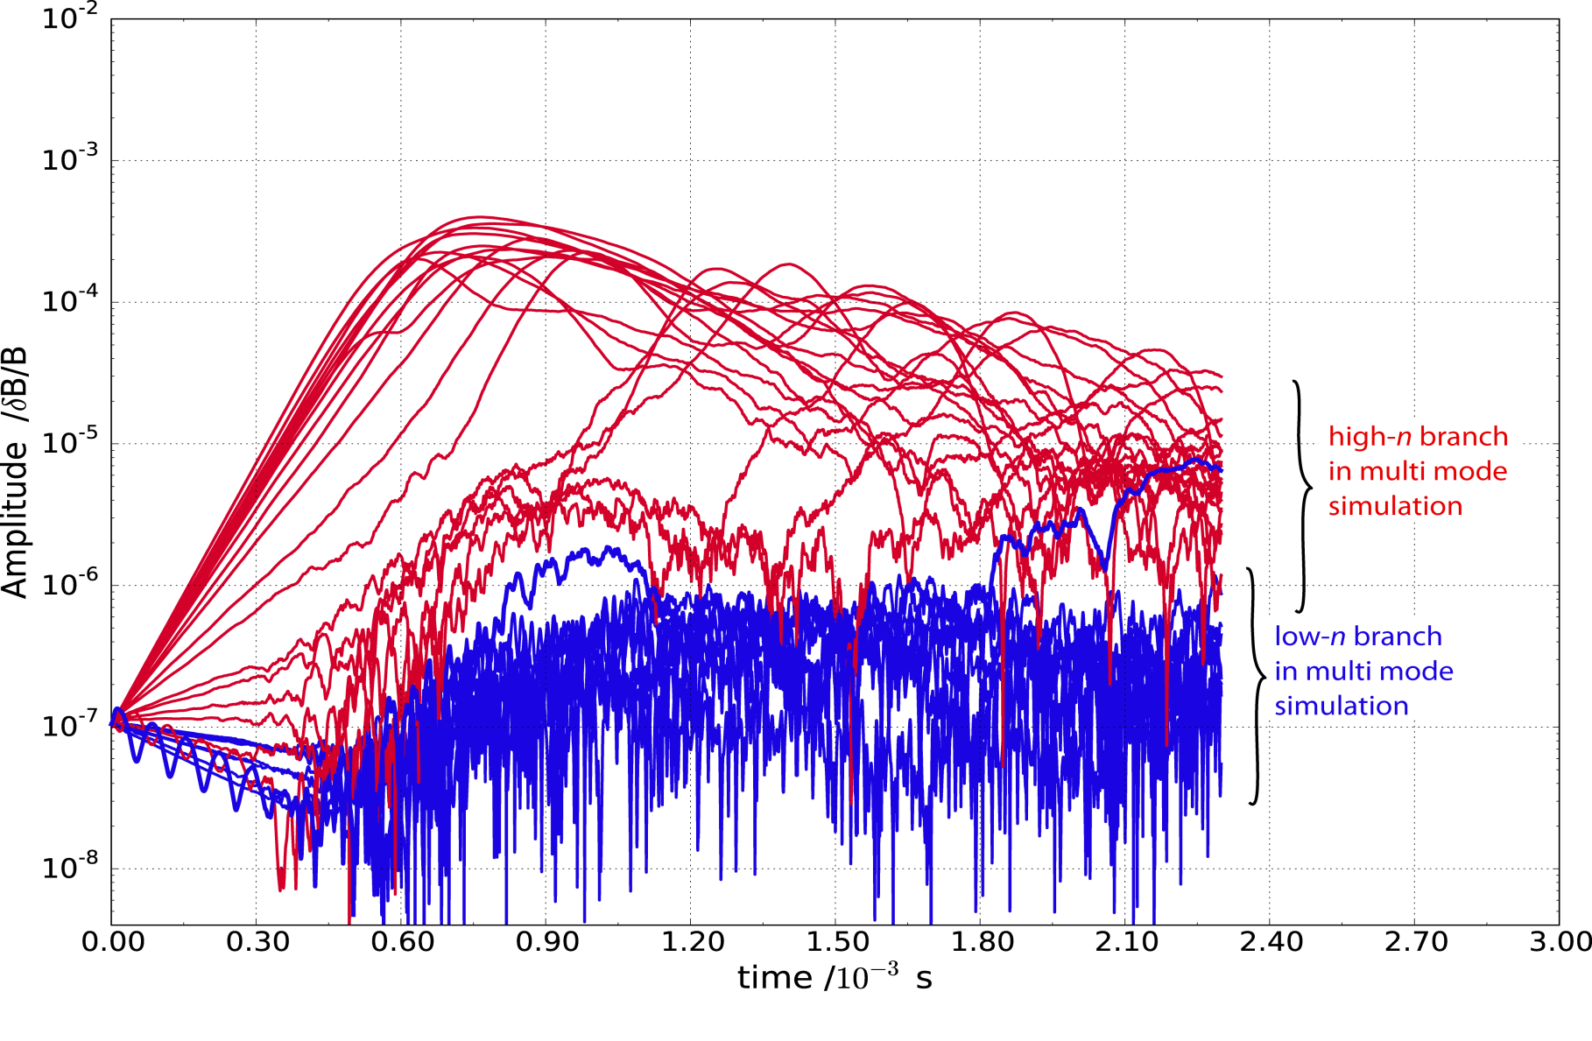
4.6 Nonlinear Findings: Growth & Amplitudes
Multi mode case (default EP density profile, LIGKA damping): n=5..12,n=12..30
Low-n branch not excited → no domino effect
Notes:
This is from ITER_15MA_2014 runs: 162, 150-59,171-178,184-192

Slide 36
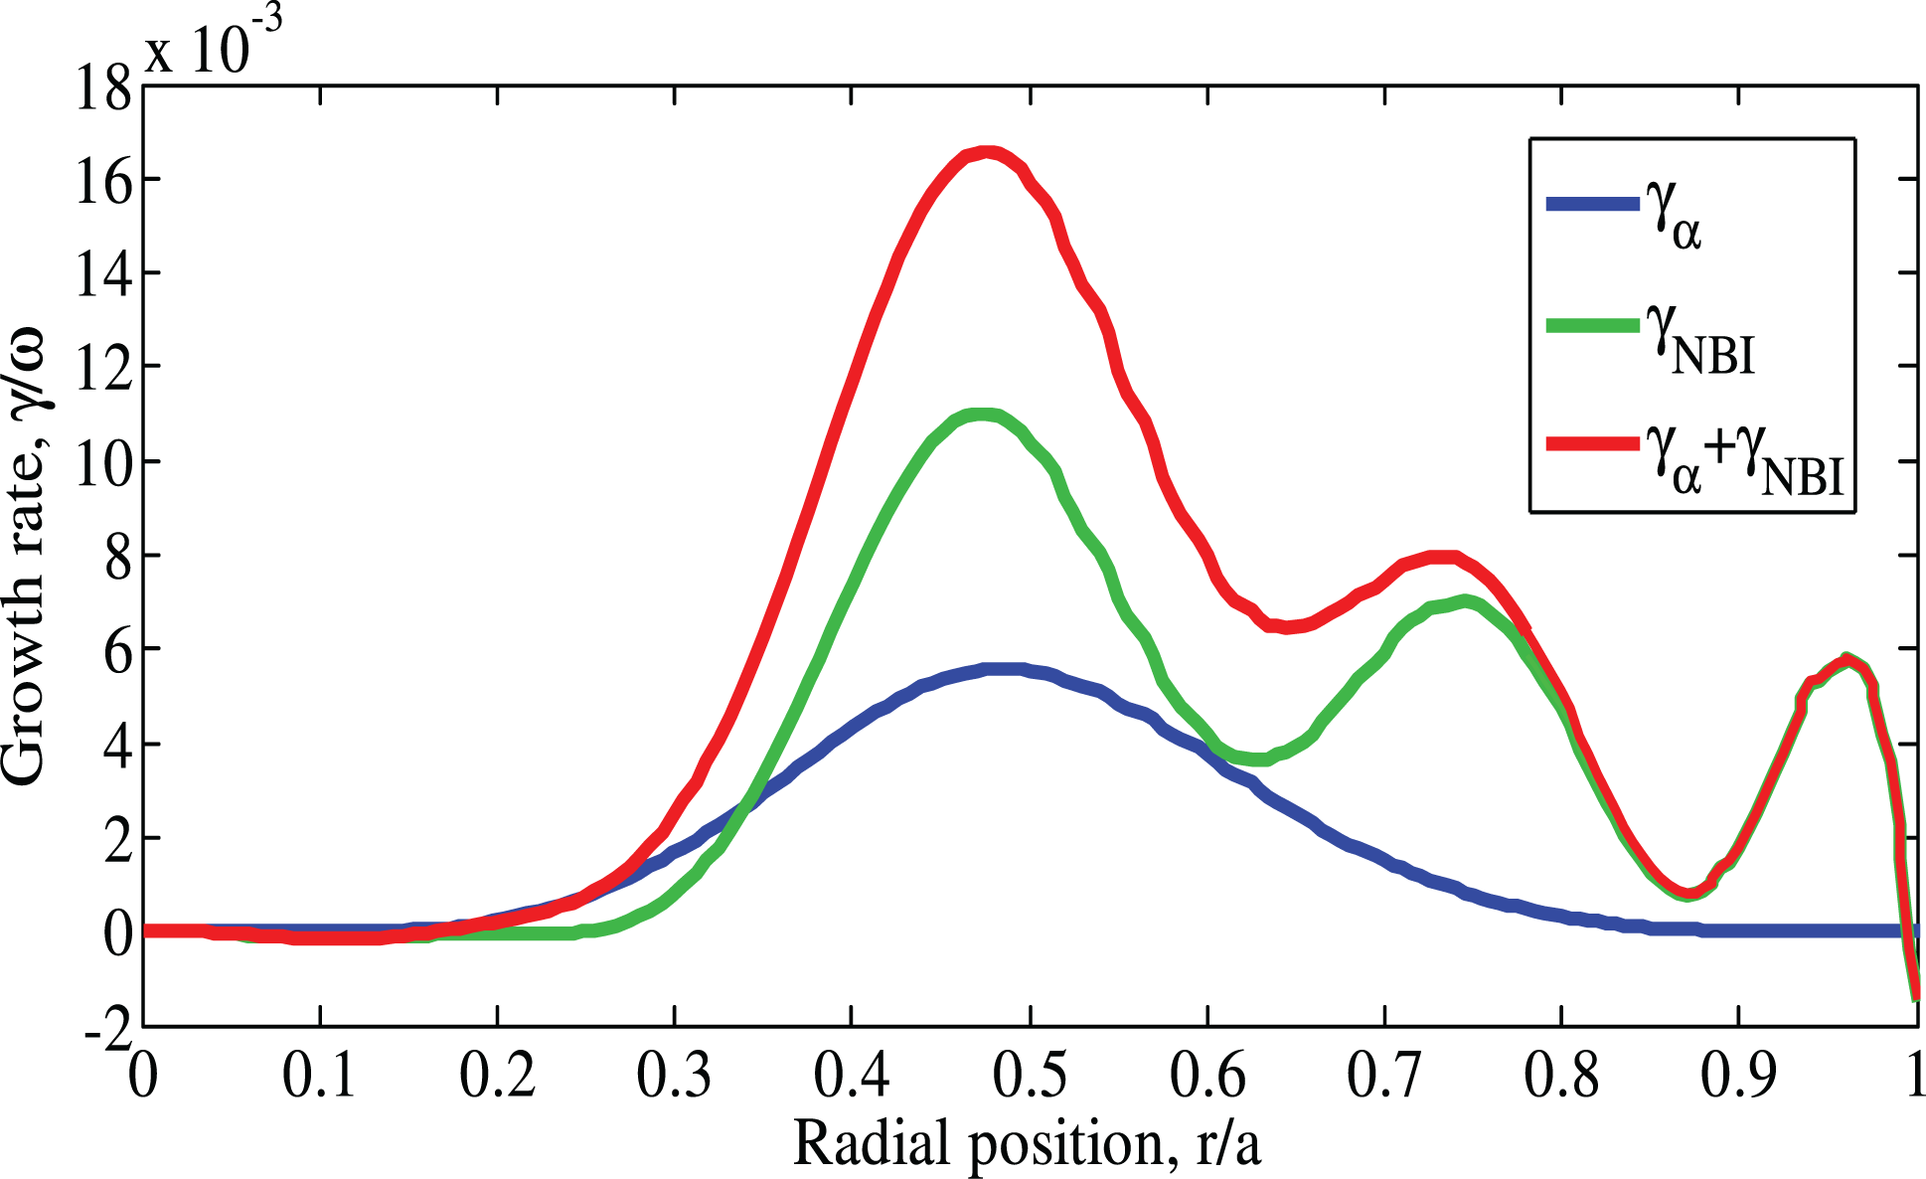
4.6 Nonlinear Findings: impact of NBI EP
In ITER, besides alpha particle drive, strong NBI drive is expected,
especially for the outer modes:
Multi-species implementation (for alpha+NBI) into HAGIS is in the testing phase.
Until finished…
[Polevoi’02 ,
Pinches’15]
Notes:
This is from ITER_15MA_2014 runs: 162, 150-59,171-178,184-192

Slide 37
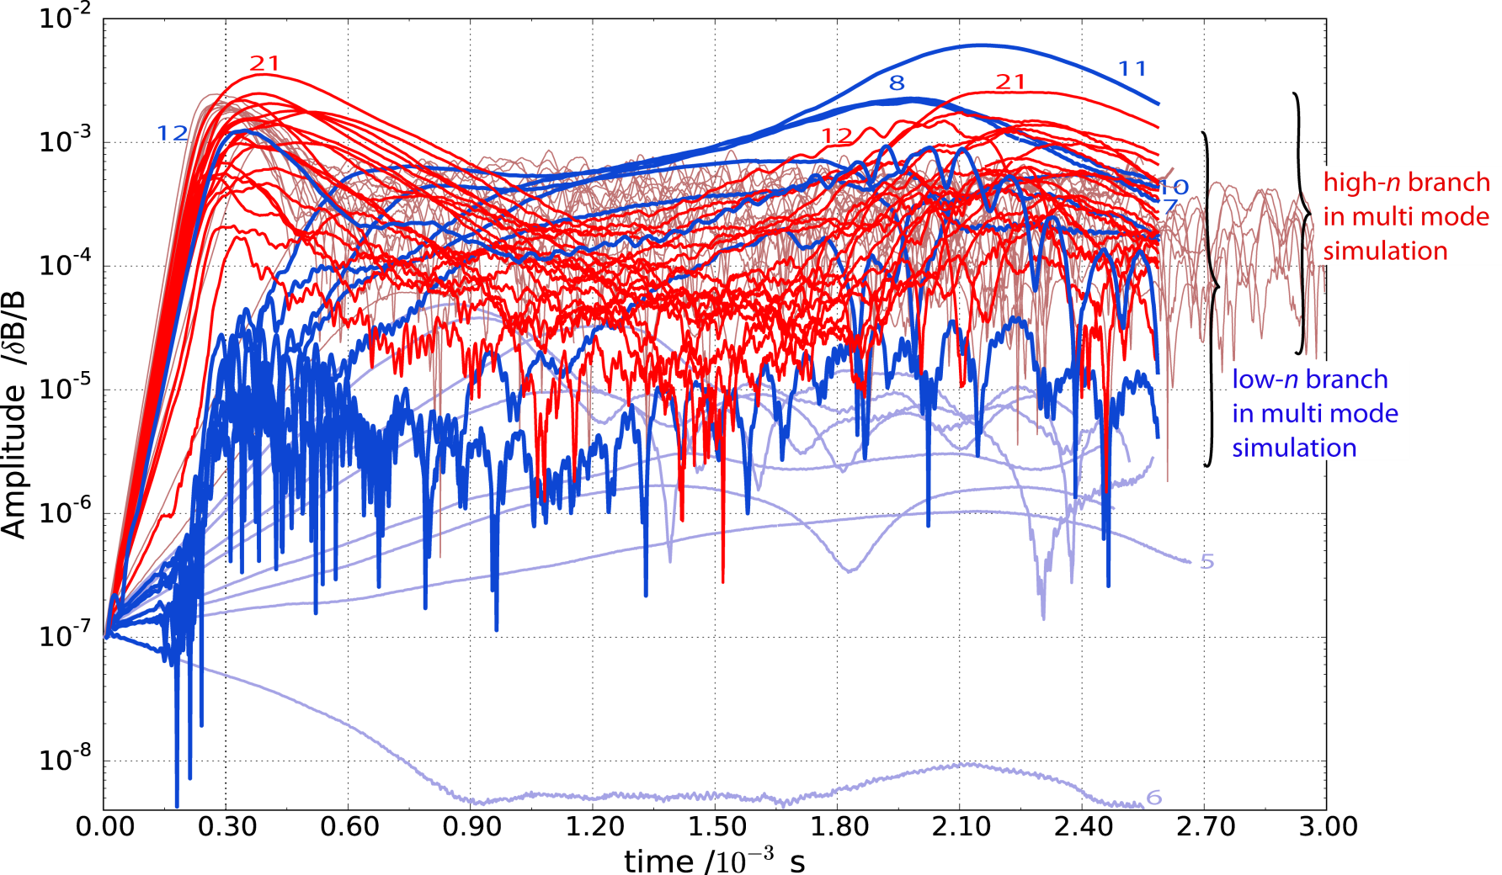
4.6 Nonlinear Findings: Growth & Amplitudes
Multi mode case (200% EP density profile, LIGKA damping): n=5..12, n=12..30
Due to the damping, the dynamics has changed (cp. p. 29): when low-n modes at max., high-n decayed → second enhancement of high-n on average slightly lower → domino effect weaker.
Notes:
This is from ITER_15MA_2014 runs: 162, 150-59,171-178,184-192

Slide 38
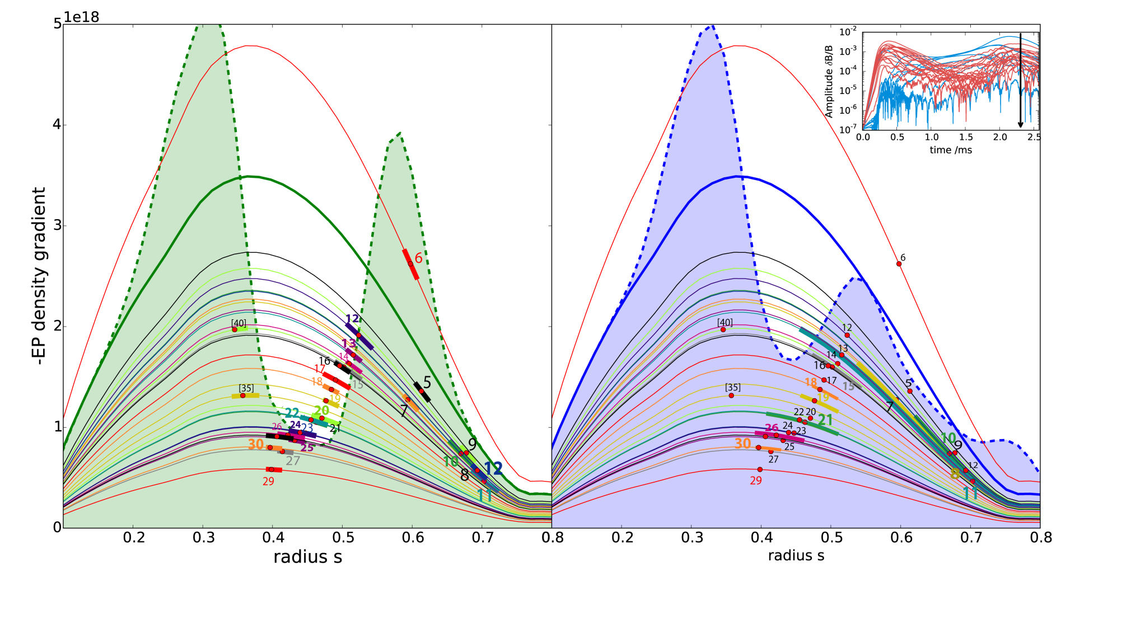
4.6 QL v.s. Nonlinear Radial Transport
domino-like behaviour,
but weaker.
Thick colored: width of mode (δB/B>10⁻³)
Notes:
This data is from ITER_15MA_2014 run 241 (redistribution=blue) and runs in folder “betascaling” (beta_crits=red dots): plot_radial_betacrit_diff2NL.py. The width of the modes (thicker parts of lines) is obtained from HAGIS_DIAG.py -> mode.py -> Plot_2Ddata_sth

Slide 39
4.6 QL v.s. Nonlinear Radial Transport
Notes:
This data is from ITER_15MA_2014 run 241 (redistribution=blue) and runs in folder “betascaling” (beta_crits=red dots): plot_radial_betacrit_diff2NL.py. The width of the modes (thicker parts of lines) is obtained from HAGIS_DIAG.py -> mode.py -> Plot_2Ddata_sth

Slide 40
5.Conclusions: domino-like EP Transport in “worst-case’ ITER ?
No quantitative prediction possible yet, due to the limitations of the model – this work aims to demonstrate possibility of a domino-like effect which has been observed in ASDEX Upgrade.
Above a relatively high EP density (β), low-n branch is excited $\left(n∈\left[5,12\right]\right)$by EP redistribution of higher-n branch $\left(n∈\left[12,30\right]\right)$ due to resonance overlap
EP redistribution radially far outside ($s≈0.8$)
saturation amplitudes are much higher in multi mode case compared to single mode case (up to factor 10 for high-n, x60 for low-n) and show complex nonlinear dynamics (time when diffusive transport regime sets in depends on phase space position (s,E))
local QL estimate can be too optimistic for “worst-cases”,
overshoot effect possible
in multi mode scenario, nonlin. dominant modes (n=12,21,30) are lin. sub-dominant
not sufficient to look at linear phase only, where n=30,26,29 show highest ɣ
This behavior is based on nonlinear and global effects and may be prevented by
different shear, q profile tayloring (avoid flat around 1)
establishes transport barrier betw. core and edge by radially separating & localizing TAEs
density ρ shaping (“box-like”) increased damping for low-n TAE branch.

Slide 41
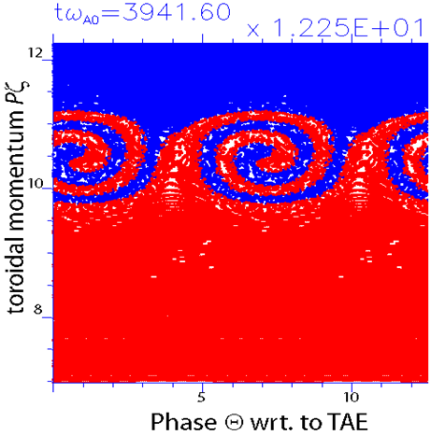
5.Outlook: Theoretical Understanding & Physical Consequences
color: initial P_{ζ}
Example of phase space dynamics (wave-particle trapping) from ITPA n=6 TAE nonlinear benchmark
Investigate particle transport (when resonant, diffusive?) and dynamics in phase space with HAMILTONIAN MAPPING TECHNIQUE [Briguglio’14]
HAGIS simulated sum of all amplitudes δB_{r}/B (color) and loss information (dots) from ASCOT (only by field ripple)
Investigate EP losses caused by redistribution meeting field ripples, islands, … using the ASCOT [Hirvijoki’14] code.
Notes:
Plotting tool (right): mode.py -> Plot_2Ddata_Rz; data for losses was given by Antti, produced with ASCOT w/o any islands or TAE (just field ripple)
Plotting tool (left): Hamiltonian Mapping for ITPA n=6 TAE for run008

Slide 42
6. Study of Saturation Mechanisms with the ITPA n=6 TAE Benchmark Case
1. Setup and Linear Benchmark
2. Review of Saturation Mechanisms
3. Nonlinear Benchmark using the
Hamiltonian Mapping Technique
4. Conclusions & Outlook II

Slide 43
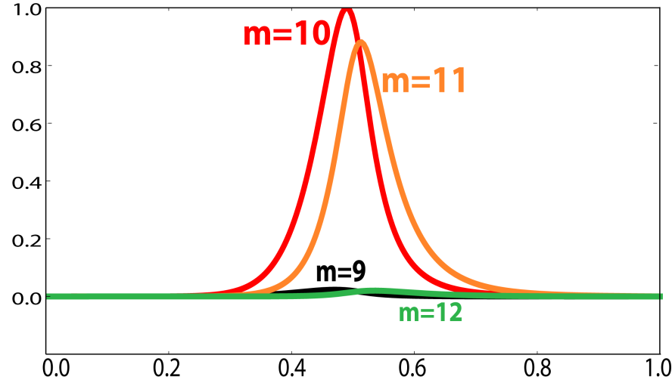
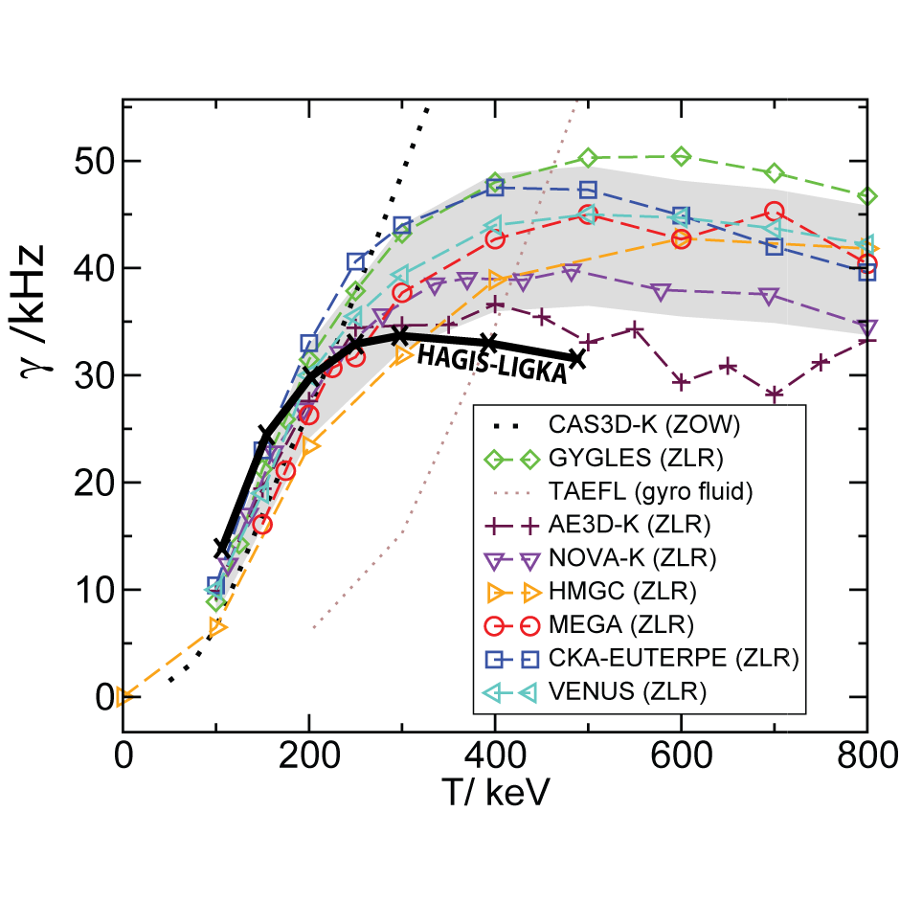
6.1 ITPA n = 6 TAE benchmark: setup & linear
The ITPA n=6 TAE benchmark [Mishchenko’09]:
large aspect ratio (A=10, R=10) geometry
q(r)=1.71 + 0.16 (r/a)²
B_{mag}=3 T
H bulk plasma: n_{e}=n_{i}=2.0 ·10¹⁶ m⁻³,T_{e}=T_{i}=1keV
D as EPs, Maxwellian, n(s) α exp{-tanh{(s)}}
Variation in T_{EP} ;
Long-term goals:
compare with HMGC
→ study importance of mode
structure evolution
implement and get familiar with Hamiltionian Mapping Technique (HMT) [Briguglio’14] to apply it to ITER single mode cases

Slide 44
6.2 Energetic Particle – Alfvénic Wave Interaction
Energy exchange $δE ∝ \frac{∇ \left[\left(\frac{∂f}{∂E} − \frac{∂f}{∂Pζ}\right) ∙ φ \right]}{ω−ωres}$

Slide 45
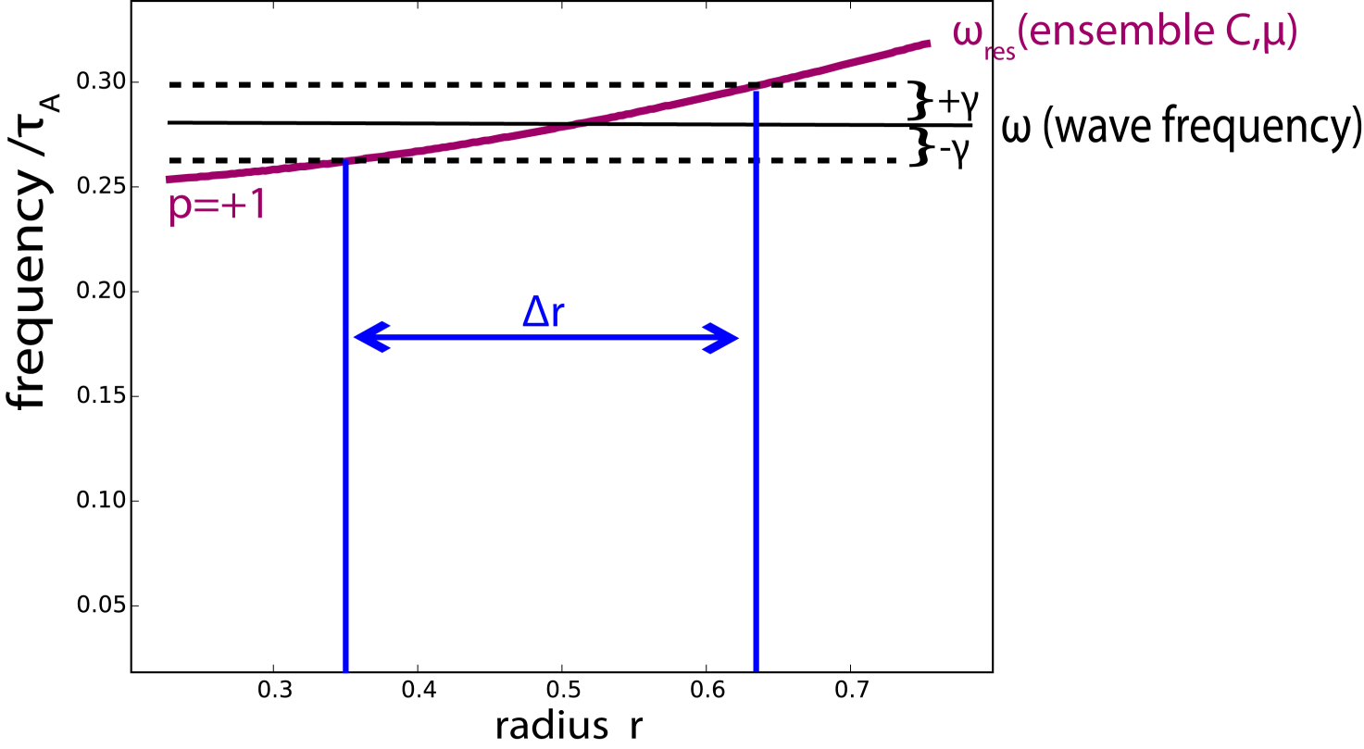
5.2 Explanation: Resonance Broadening
Plotting ω_{res} for certain ensemble (fixed C=E-ω/n P_{ζ},μ) in P_{ζ}, i.e. radial space
compared with mode frequency ω
ω is complex → broadens by ɣ
results in a radial width of the resonance, depending on ɣ and q profile
can be compared to the radial mode extension

Slide 46
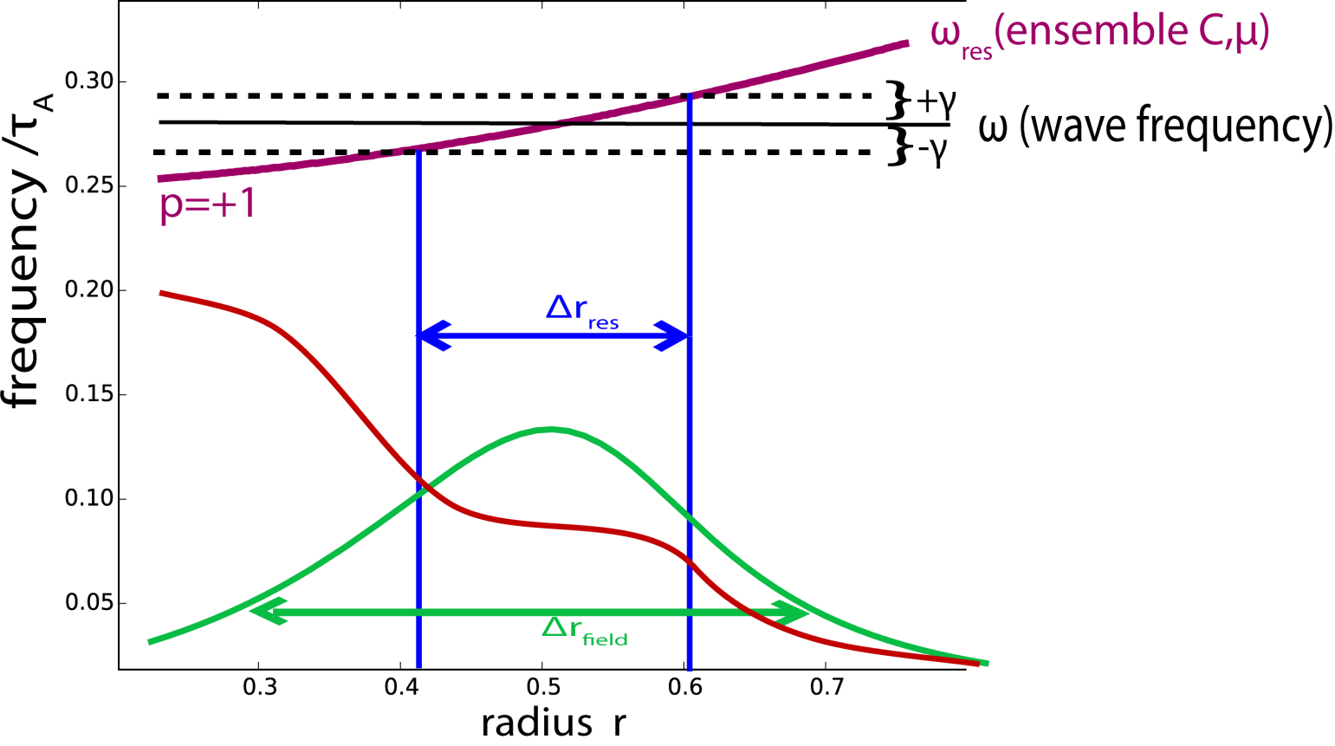
6.2 Explanation: Resonance Broadening
Resonance detuning:
the resonance width is smaller than the mode width and determines the flattening region ← ɣ is small, high shear, broad modes/high amplitudes

Slide 47
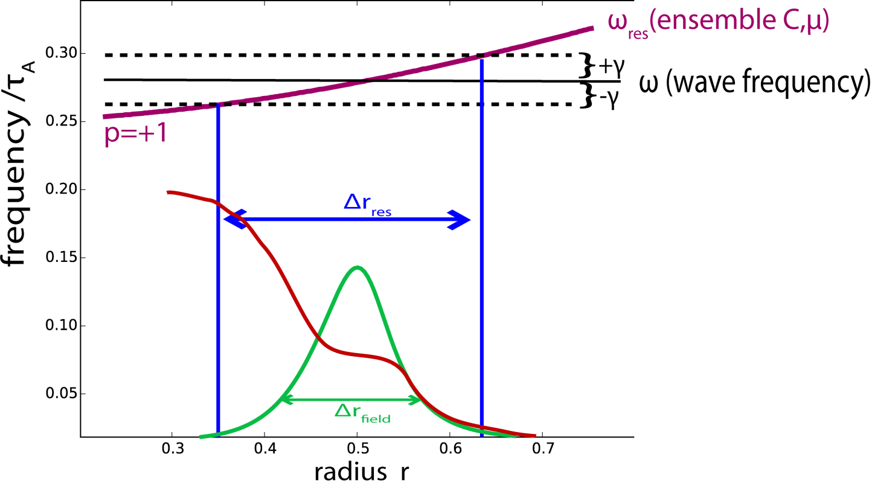
6.2 Explanation: Resonance Broadening
Radial decoupling:
the mode width is smaller than the resonance width and determines the flattening region ← high ɣ, low shear, localized modes/low amplitudes

Slide 48
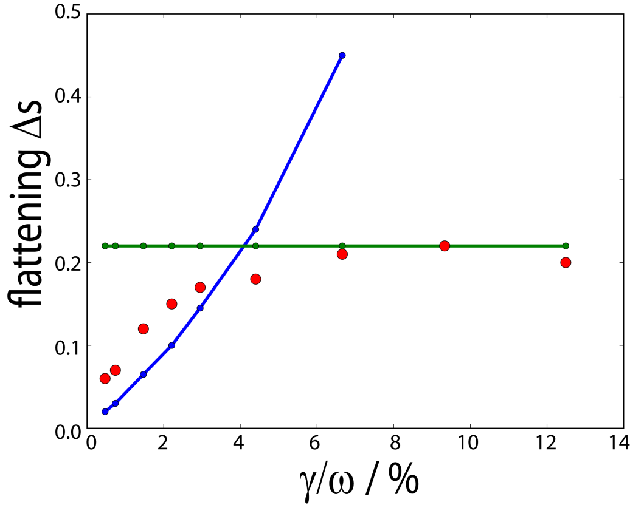
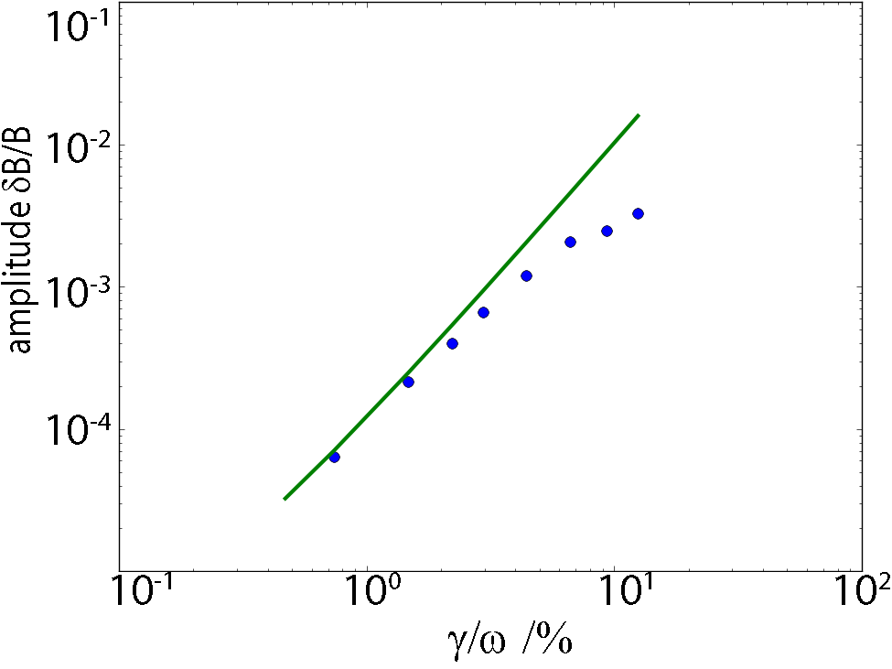
6.3 Nonlinear ITPA Benchmark (status)
radial flattening over linear growth rate:
regimes found as also by HMGC
amplitude over linear growth rate:
quadratic dependence for low growth
“resonance detuning” regime
“radial decoupling” regime
quadratic
dependence
HMGC

Slide 49
6.3 ITPA Benchmark: Hamiltonian Mapping
ensemble of passive “test” markers is chosen, characterized by the same constants of (perturbed) motion (μ, C=E-ω/n P_{ζ},), such that it is resonant with the mode of frequency ω. The whole radial space (P_{ζ}) is filled with these passive markers.
The HMT tool analyzes power exchange (fig.s this slide) and phase space structure formation over time (fig.s next slide).
case of second lowest ɣ

Slide 50
6.3 ITPA Benchmark: Hamiltonian Mapping
color: initial P_{ζ}
color: energy exchange
case of second lowest ɣ simulated with HAGIS

Slide 51
6.4 Conclusions & Outlook II
Passive species & Hamiltonian Mapping implemented successfully into HAGIS
nonlinear ITPA n=6 TAE benchmark: regimes of radial decoupling and resonance detuning could be identified
Further steps:
Apply the Hamiltonian Mapping Technique to ITER single mode cases to learn about saturation mechanism.
Problem: how to analyze multi mode case?

Slide 52
Backup Slides

Slide 53
ASDEX Upgrade: resonances
AUG#23824
inverted q profile (t=1.16s) monotonic q profile (t=1.51s)

Slide 54
ASDEX Upgrade: numerical vs. experiment
FILD signal: magnetic pick-up coil (HF):

Slide 55
ASDEX Upgrade: numerical vs. experiment
In the high energy range, the losses are correlated to mode or beat frequency:

Slide 56
4. Linear Findings: continuum & wave structures [Lauber’15]
The Shear-Alfvén Wave continuum: flat shear enables a broad TAE cluster around r ≈ 0.4
many poloidal harmonics especially for low n.
with increasing n modes become radially more localized & mode position moves towards core
Ideal SAW; kin. Effects modify it,
and generally decrease damping
Non-perturbatively calculated structures (incl. kin. effects)
Notes:
Gaps are wide because of low-shear and flat background density.
Frequencies in the middle of the gap due to non-perturbative effects (/= MHD result!)

Slide 57
4. Linear Findings: continuum & wave structures [Lauber’15]
𝜔_{A} ∝𝑘$∥$v_{A}
∝ $\frac{1}{q}$ $\frac{1}{\sqrt{ρ}}$
SAW continuum
Comparison between “box-like” and peaked density profile:
if the density (ρ) profile is more peaked → continuum damping decreased,
since SAW intersects with TAE structure radially further outside.
The mode structures do not change significantly.
Notes:
Reasons for low damping:
low-n branch: amplitudes of pol. harmonics are low, therefore weak continuum damping;
high-n branch: high frequencies lead to low ion Landau damping, low shear leads to low radiative damping.

Slide 58
4. Linear Findings:continuum & wave structures [Lauber’15]
$$qTAE=\frac{m+1/2}{n}$$
Comparison between flat/”box like” and peaked q profile:
If the q profile is not continuously close to 1 → less dense cluster of TAEs,
more localized TAE structures – both can serve as transport barrier
Notes:
Reasons for low damping:
low-n branch: amplitudes of pol. harmonics are low, therefore weak continuum damping;
high-n branch: high frequencies lead to low ion Landau damping, low shear leads to low radiative damping.

Slide 59
Linear Findings: drive & resonances
λ=0.6
n=12 (blue)
n=21 (yellow)
n=30 (red)
λ=1.0
s=0.5
s=0.5
Notes:
Reasons for drive:
k_theta * banana-orbit = 1,
high EP density gradient

Slide 60
nonlinear Behavior: Density Threshold for Domino Effect
Notes:
Plotting tool: fit_densgamma.py. The runs are single mode runs with different densities w/o any damping, in folder “betascaling”. The LIGKA damping is subtracted from the growth rate in the fit script, such that the zero line here means linear growth = damping.

Slide 61
6. nonlinear Redistribution
The redistribution (here in color: change of pressure) moves outwards with time
redistribution/flattening becomes energy dependent (due to FOW effects?, when the broad low-n modes become strong).

Slide 62
Explanation: “Width” of Resonance
resonances have a certain width in phase space, because many potential ensembles of particles (P_{ζ},μ,C) fulfill the resonance condition (especially if the q profile is flat, since ω_{b} and ω_{D} depend on q).
fixing (μ,C), not P_{ζ}
→ picking 1D-resonance
line for each bounce
harmonic p
→ resonance broadening
then results from
growth rate ɣ….

Slide 63
ITPA Benchmark: Lyapunov Exponent
another way of looking at phase space behavior: Lyapunov Exponent (without needing to know the resonance region)
Red: boundary of seperatrix (“water divide”)
for
and
case of second lowest ɣ simulated with HAGIS

Slide 64
ITPA Benchmark: radial excursion vs. time
Saturation occurs (even for this week case) after one/few trapping orbits:
HMGC
HAGIS

