Slide 1
Modelling of ECCD applied for NTM stabilization
E. Westerhof
FOM Institute DIFFER
Dutch Institute for Fundamental Energy Research

Slide 2
Overview
Modelling of ECCD applied for NTM stabilization
1) Taking into account the flux surface topology in the presence of magnetic islands
wave propagation and absorption
plasma kinetic response
2) Taking into account ECCD in nonlinear plasma fluid models
closure relations
3) The generalized Rutherford equation revisited
relative contributions of δΔ’(δj) and Δ’_{δj}

Slide 3
Basic assumptions
ECCD applied for NTM stabilization
Separation of time scales:
τ_{wave propagation} << τ_{kinetic}, τ_{rotation} << τ_{mode growth}
Quasi-steady state with helically closed magnetic surfaces
T_{e} and n_{e} functions of perturbed flux surfaces

Slide 4
Plasma configuration
Plasma geometry defined by 2D equilibrium ψ_{eq}(R,Z)
equilibrium helical flux
introduce r_{c}
straight field line angle θ_{s} at r_{s}
helical flux perturbation

Slide 5
Plasma profiles
T_{e} and n_{e} functions of perturbed flux surfaces
at r > r_{s} outside island
inside island
at r < r_{s} outside island

Slide 6
Wave propagation and absorption
Modified flux surface geometry implemented in TORAYFOM ray tracing code
Minor changes in ray trajectories
Fundamental changes in power deposition
  high p(ψ) for O-point heating (small dV)
  high p(ψ) for X-point heating (large dP due to flux expansion)
Previous work by Isliker et al. (2012) Plasma Phys. Control. Fusion 54 095005

Slide 7
Power deposition profile p(ψ(x_{LFS}))
ECCD in a 4 cm wide 3/2 NTM on ASDEX Upgrade #26827
as function of LFS minor radius in the plasma cross section with O-point in LFS mid plane
without island p_{ECRH}(x) < 4 MW/m³

Slide 8
Consequences of high power density
Threshold for nonlinear effects
Harvey et al. Phys. Rev. Lett. (1989) 62 426

Slide 9
Fokker-Planck modelling
Fokker-Planck code RELAX adapted to solve bounce averaged FP equation on island flux surfaces
Approximations
inside island:
bounce integrals ≈ bounce integral on r_{s}
outside island:
bounce integrals on equivalent r_{eq}
Effect of island contained in dV(ψ)

Slide 10
CW O-point ECCD in locked island
Nonlinear effects result in reduction of global ECCD efficiency
small effect for experimentally relevant P_{ECCD}

Slide 11
CW ECCD in a rotating island
23 kHz 3 kHz
J_{ECCD} fluctuates as island rotates through heating zone
maximum current reached well after passage through heating zone (Fisch-Boozer effect)
immediate, opposite response to heating from Ohkawa effect

Slide 12
Effect on Δ’_{CD} in Rutherford equation
Strong oscillations in Δ’_{CD} for low frequency rotation
negligible nonlinear effects for P_{ECCD} up to 4 MW
time average equal to steady state phase averaged Δ’_{CD}

Slide 13
MHD closure in presence of ECCD

Slide 14
Closure relations
Assuming a linear response to all driving forces Ohm’s law must be changed to
Model for J_{EC} is required
Properties of ECCD
dominantly driven by Fisch-Boozer effect
non-local in time and space
localized in velocity space (v_{res})

Slide 15
A simple picture of ECCD
At v_{||,res} ECCD creates a hole at low v⊥ and a bump at high v⊥
Collisions fill the hole at low v⊥ faster than the bump at high v⊥ is eroded ⇒ net current
During the process the velocity space perturbation is convected out of the heating zone with v_{||,res}
Embodied in 2-current model for J_{EC} = J₁ + J₂

Slide 16
Validation of two current model
Comparison of two current model with full bounce averaged FP calculations in rotating magnetic island
collision frequencies ν₁ = 88 kHz and ν₂ = 15 kHz
ECCD efficiency -0.0085 A/W
lim ν₁ → ∞ corresponds to Giruzzi et al. 1999
23 kHz 3 kHz

Slide 17
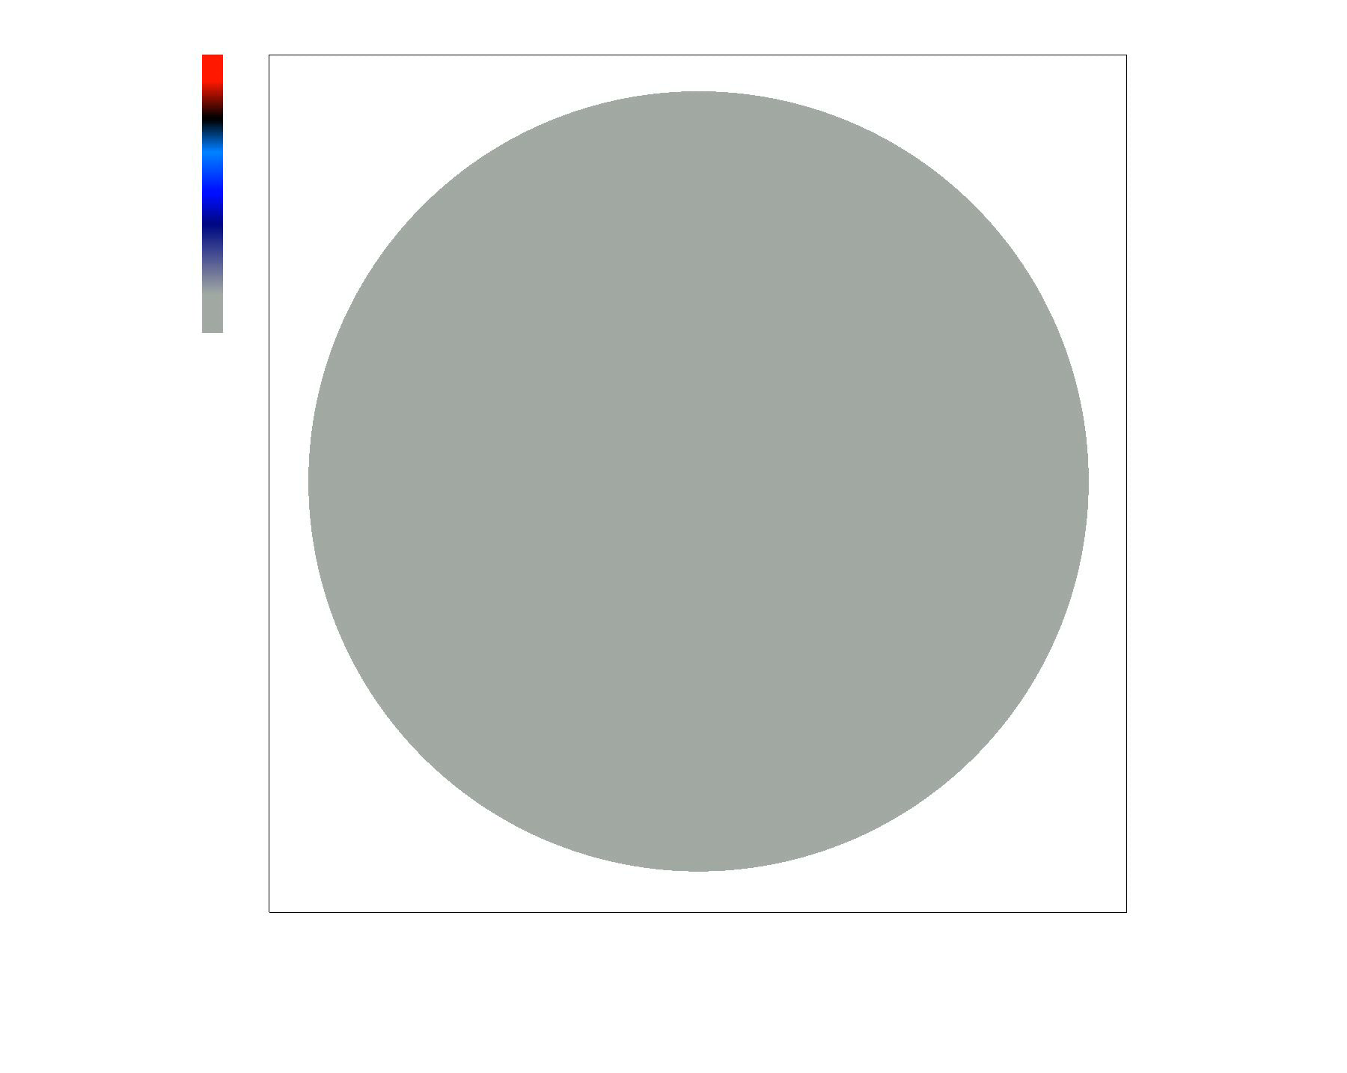
2 current model implemented in JOREK
From a poloidally and toroidally homogeneous P_{ECCD} to a J_{ECCD} distribution inside the magnetic island
more to follow soon

Slide 18
Back to the
generalized Rutherford equation

Slide 19
Two effects of ECCD
Change to exterior matching parameter Δ’
Effect of helical current in interior solution
Note the infinite radial integration domains

Slide 20
Matching at the edge of the island
For δΔ’(j_{EC}):
and complementary for Δ’_{EC}

Slide 21
Matching at the edge of the island
For δΔ’(j_{EC}):
and complementary for Δ’_{EC}
Analytical calculation:
for J_{EC}(Ω) with Ω = 8(x/w)² – cos ξ, the radial integrands of δΔ’(δj_{EC}) and Δ’_{EC} are identical up to a small second harmonic term

Slide 22
Validating GRE on 2D reduced MHD
2D reduced MHD code solving
Discretization:
radial finite differences
helical angle Fourier decomposition
Boundary conditions
matching to Δ’ from “exterior solution”
Equilibrium:

Slide 23
Stabilization of NTM by ECCD
Model parameters:
Linearly stable mode Δ’ = 1 m⁻¹
Bootstrap current perturbation –J_{bs} inside island
CW ECCD with full Gaussian width w_{EC} = 1 cm averaged over flux surfaces

Slide 24
Testing the bootstrap drive
Largest effect from the poloidally averaged current perturbation k=0 (only after finite diffusion time)
Response to helical current perturbation k=1 is immediate

Slide 25
Testing the ECCD term(s)
De Lazzari and Westerhof 2009
Full effect of ECCD contained in Δ’_{ECCD}
In all cases the dominant effect comes from the poloidally averaged current perturbation

Slide 26
Summary and Conclusions
Ray-tracing and Fokker-Planck codes for ECCD modelling in presence of magnetic islands
  applications to NTM control
  Ayten et al. Nucl. Fusion 54 (2014) 073001
New 2 current closure model for ECCD
    validated on Fokker-Planck calculations
    implemented in JOREK
    Westerhof and Pratt, PoP 21 (2014) 102516
GRE validated by 2D reduced MHD simulations
  dominant contribution from poloidally averaged rather than helical current perturbation
  full effect of ECCD contained in commonly used expression for Δ’_{ECCD}
  letter to be submitted

Slide 27
Acknowledgement
Many thanks to my coworkers
Bircan Ayten
Hugo de Blank
Jane Pratt
The JOREK results were obtained on the HELIOS supercomputer of IFERC at Rokkasho Japan.
This project was carried out with financial support from NWO. The work has been carried out within the framework of the EUROfusion Consortium and has received funding from the Euratom research and training programme 2014-2018 under grant agreement No 633053. The views and opinions expressed herein do not necessarily reflect those of the European Commission

Slide 28
A closer look at the analysis
For any δj_{i}(Ω) where
Conclusion:
The integrands of δΔ’(δj_{i}) and Δ’_{δj} are identical up to a small second harmonic term

